Slide 1
Advisory Committee Interim Meeting #1 Rental housing Study
Montgomery County, Maryland
June 26, 2015
Presented by:
Kyle Talente, Vice President & Principal
RKG Associates, Inc.
Jesse Wiles, Chief Operations Officer
APD Urban Planning and Management, LLC

Slide 2
MEETING AGENDA
Staff Changes
Revision to Summary of Last Month’s Meeting
Presentation of Submarket Boundaries
Neighborhood Analysis Introduction
Contacts/Stakeholder Discussion
Next Steps

Slide 3
STAFF CHANGES

Slide 4
PROJECT ORGANIZATION
Montgomery County
County Executive, County Council, Planning Board
Planning Department
Technical Committee
Advisory Committee
RKG
Kyle Talente
CHP
Lisa Sturtevant
APD
Jesse Wiles
Consultant Team
Montgomery County Community
DHCA

Slide 5
CONTACT INFORMATION
Ms. Elizabeth Davison
Acting Chief of Research and Special Projects
Montgomery County Planning Department
8787 Georgia Avenue
Silver Spring, MD 20910
301-650-5600
Mr. Kyle Talente
Vice President & Principal
RKG Associates, Inc.
300 Montgomery Street #203
Alexandria, VA 22314
703.739.0965 x1
kst@rkgassociates.com

Slide 6
SUBMARKET BOUNDARY DISCUSSION

Slide 7
HOW WILL THEY BE USED?
All analyses will be done at County and submarket level
Determine imbalance of market
Internally and inter-market
Gap analysis will discern market disparities
Influence cost-benefit assessment
Model neighborhood analysis provides nuanced assessment
Component of best practices analysis
Not all programs will work everywhere!

Slide 8
SUBMARKET BOUNDARIES
Collaboration between Planning Staff and Consulting team
Considered a number of factors
Demographics
Economic base
Development patterns
Market conditions
Transportation
Natural boundaries

Slide 9
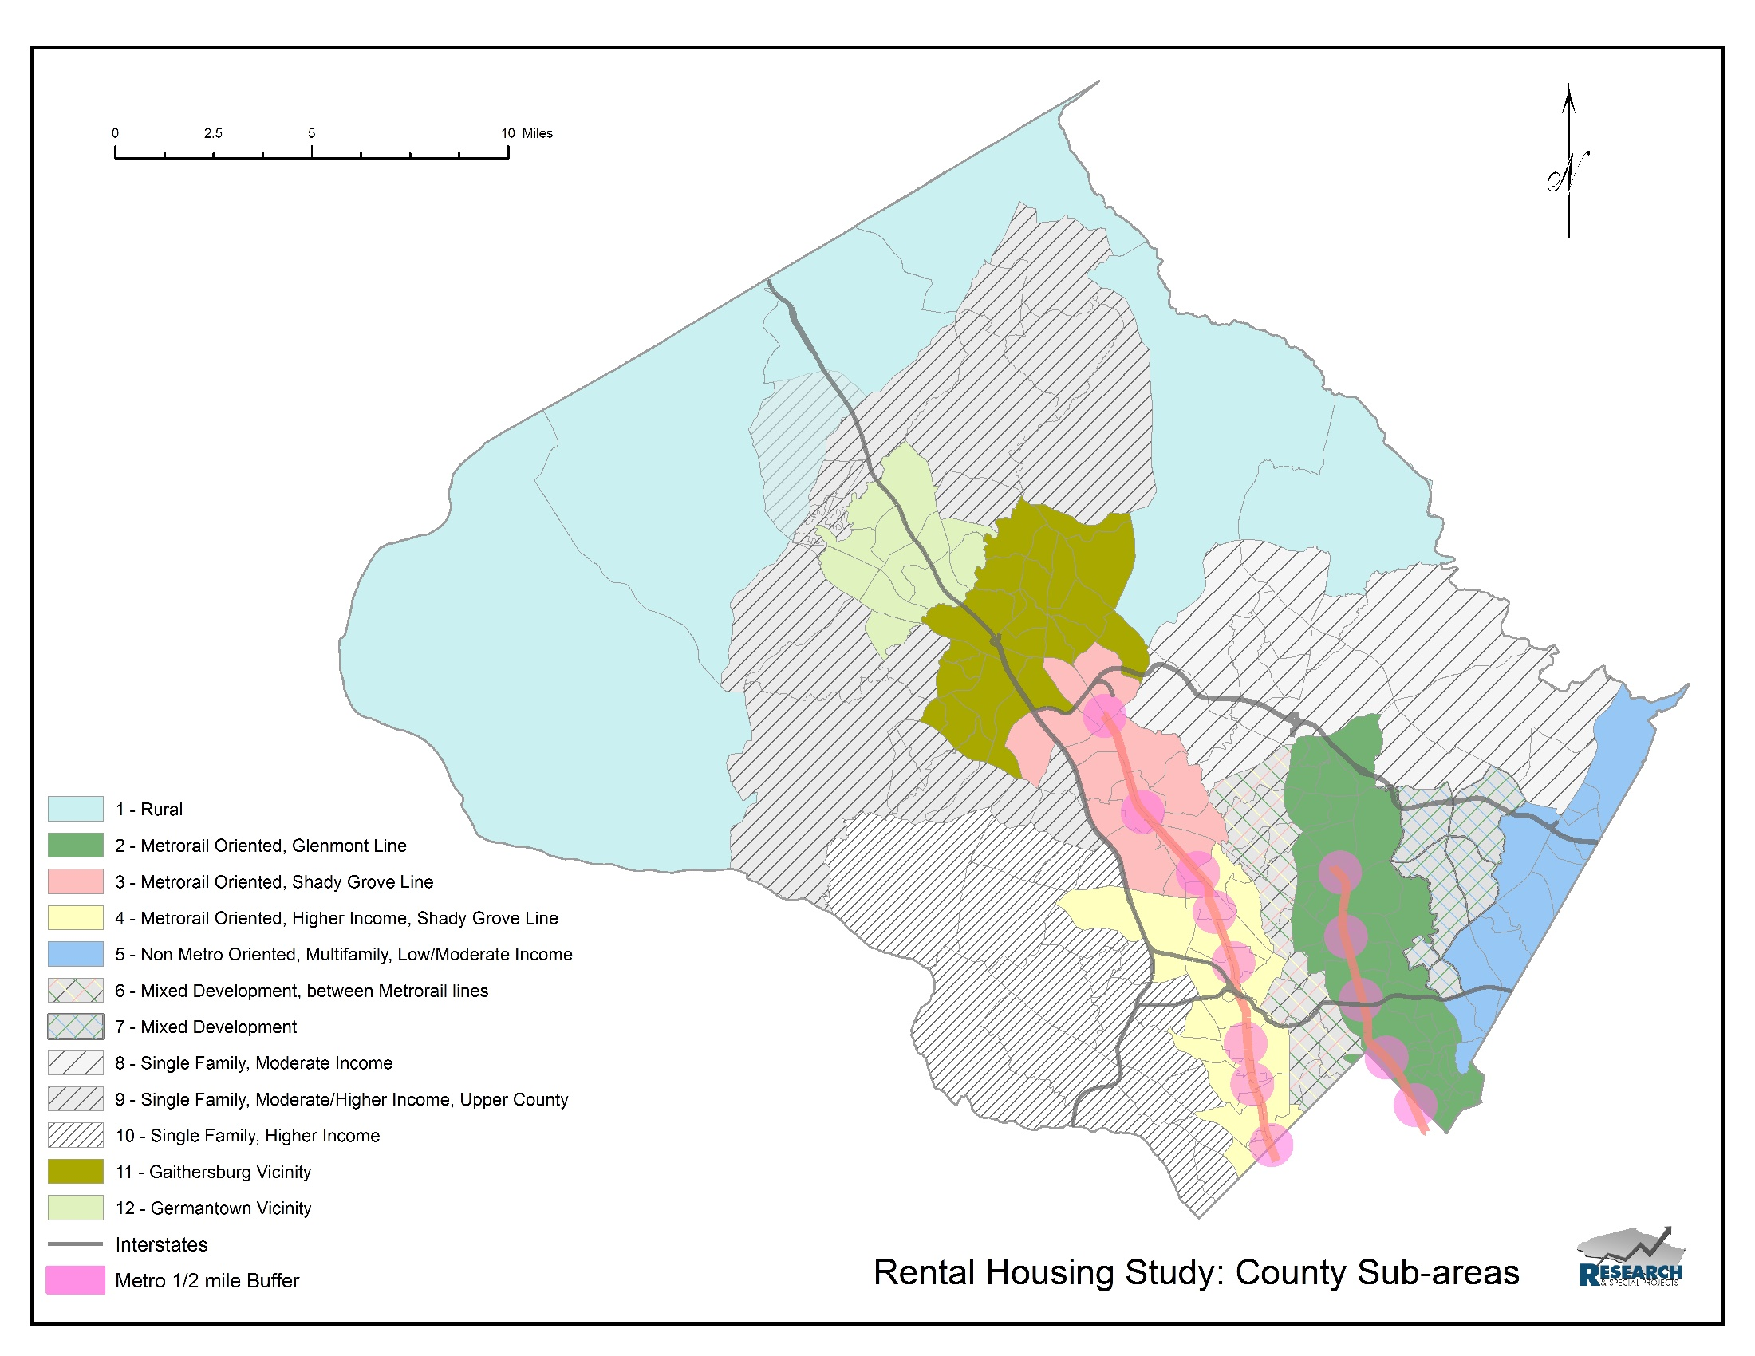
SUBMARKET BOUNDARIES
Analysis both Countywide and

Slide 10
MODEL NEIGHBORHOOD INTRODUCTION

Slide 11
Model Neighborhood Types
Up and coming
Neighborhood characteristics most desirable for both existing and new residents and businesses
Stabilized
Existing neighborhood characteristics demonstrate traditional values but not attracting upwardly mobile residents and businesses
At-risk/transitional
Neighborhood characteristics that demonstrate indicators of destabilization or deferred reinvestment
Disinvested
Clear signs of disinvestment and early signs that could lead to blighted neighborhood conditions

Slide 12
Assessment Process
Analysis of Existing Conditions
Refinement of Model Neighborhood Criteria
Decision Making Matrix
Identify areas/neighborhoods that hold greatest potential for enhancing/preserving/increasing affordable rental housing
Analysis Refinement
Block analysis
Model Neighborhood Programming

Slide 13
Integration of ADVISORY Committee
Model Neighborhood Type Criteria
Create matrix of defining criteria
Prioritization of Identified Model Neighborhoods
Interactive discussions to select model neighborhoods

Slide 14
Guiding Principles
Short term opportunity
Models for other similar neighborhoods
Stabilize/enrich areas beyond immediate project area

Slide 15
NEXT STEPS

Slide 16
PROJECT TIMELINE
P R O J E C T T I M E L I N E
 | Advisory Committee Meetings | Primary Tasks of Research Team
April 2015 | Introductory Meeting of Advisory and Technical Committee
 |  | Secondary Data Collection Secondary Data Analysis Identify sub-markets within County
Late Spring / Early Summer 2015 | Methodology Input – Confirm County sub-markets Identify other Key Stakeholders | Update Planning Board
 |  | Secondary Data Analysis
Late Summer 2015 | Review of Secondary Analysis
 |  | Focus Groups Interviews of Key Stakeholders Identification of Best Practices
Winter 2016 | Review of Housing Needs and Opportunities; Strategies | Update Planning Board
 |  | Test Options Community Outreach Meetings
Early Spring 2016 | Narrow Options | Meet with Planning Board, County Council, Executive
Summer 2016 | Refine Options | Meet with Planning Board, County Council, Executive
Late Summer 2016 – Final Report

