Slide 1
Welcome!
Sector Plan Workshop
July 15, 2014
1

Slide 2
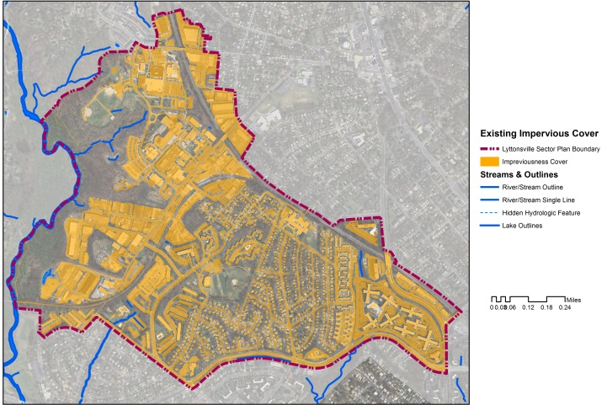
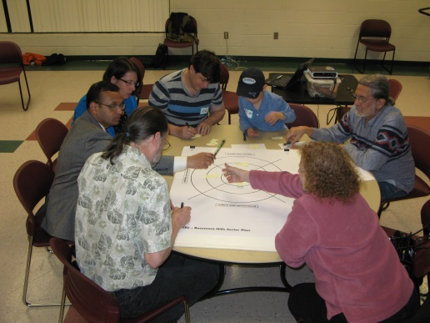
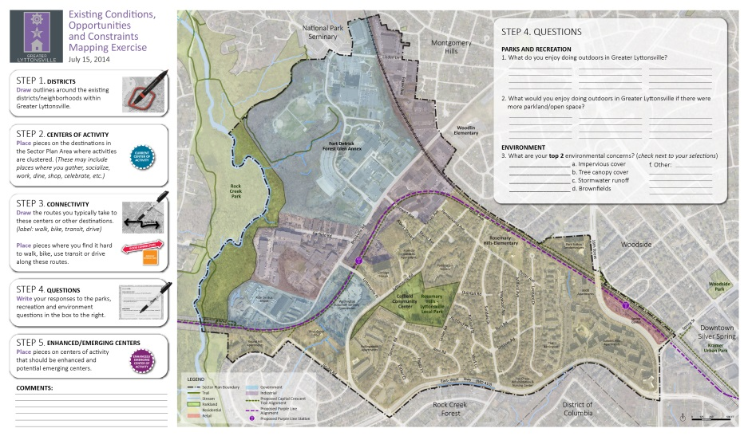
Tonight’s Format
Trivia
Presentation
Breakout Groups
Report Out
#GreaterLP
1

Slide 3
Trivia Question #1
How was Lyttonsville spelled on the 1901 record plat?
Answer:
Littonville
1

Slide 4
Trivia Question #2
What is a sharrow?
Answer:
The term sharrow comes from an abbreviated version of ‘shared-lane arrow.’ The white street symbols tell bicyclists where they should ride on the road. The symbols also indicate to drivers they are in a popular bicyclist area and should drive with caution.
#GreaterLP
1

Slide 5
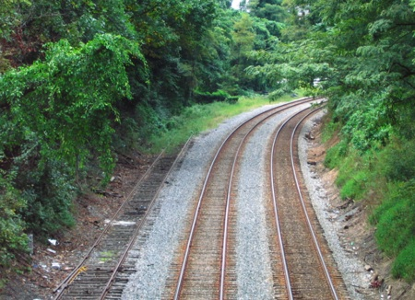
Trivia Question #3
When did the County begin planning for the Purple Line?
Answer:
1986 (Georgetown
Branch Master Plan)
1

Slide 6
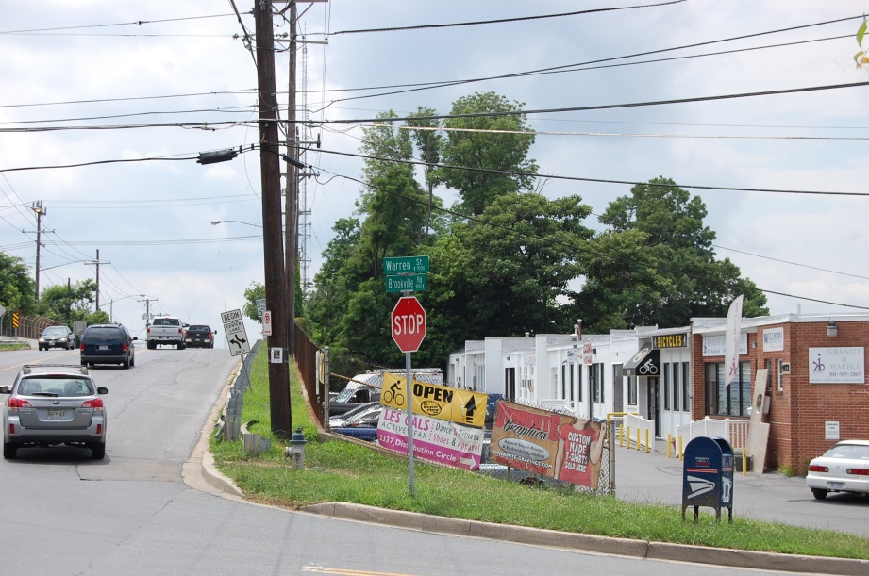
Trivia Question #4
How many businesses are located within the Greater Lyttonsville Sector Plan area?
Answer:
Approximately 475
#GreaterLP
1

Slide 7
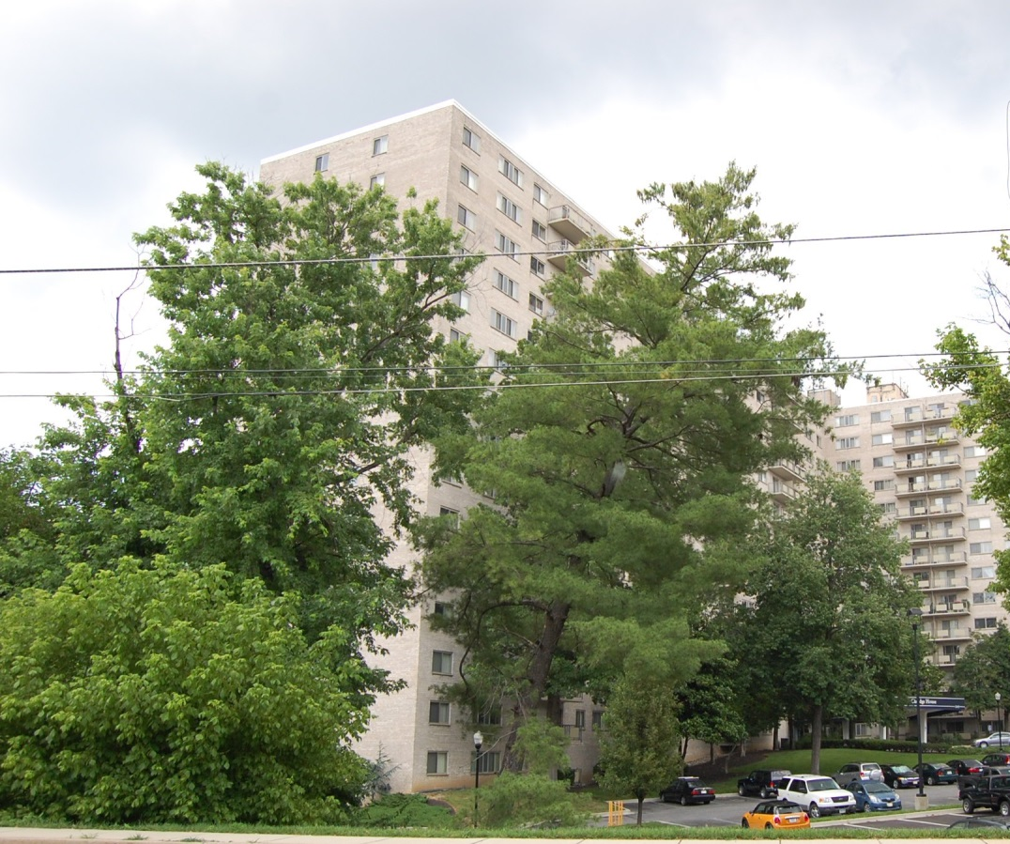
Trivia Question #5
What is the tallest building within the Greater Lyttonsville Sector Plan boundary?
Answer:
Claridge House
2445 Lyttonsville Rd
1

Slide 8
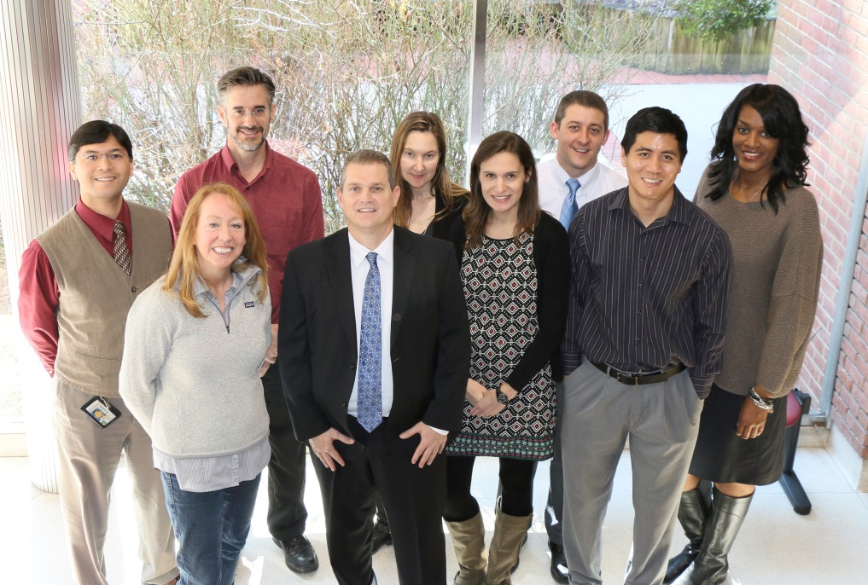
M-NCPPC Greater Lyttonsville Team
Robert Kronenberg, Chief
Marc DeOcampo, Supervisor
Erin Banks, Project Manager
Melissa Williams, Outreach
Matt Folden, Transportation
Laura Shipman, Urban Design
Chuck Kines, Parks
Lisa Tate, Research
Rick Liu, Research
Dave Anspacher, Functional Planning
Tom Autry, Functional Planning
Tina Schneider, Environment
Sandra Youla, Historic Preservation
1

Slide 9
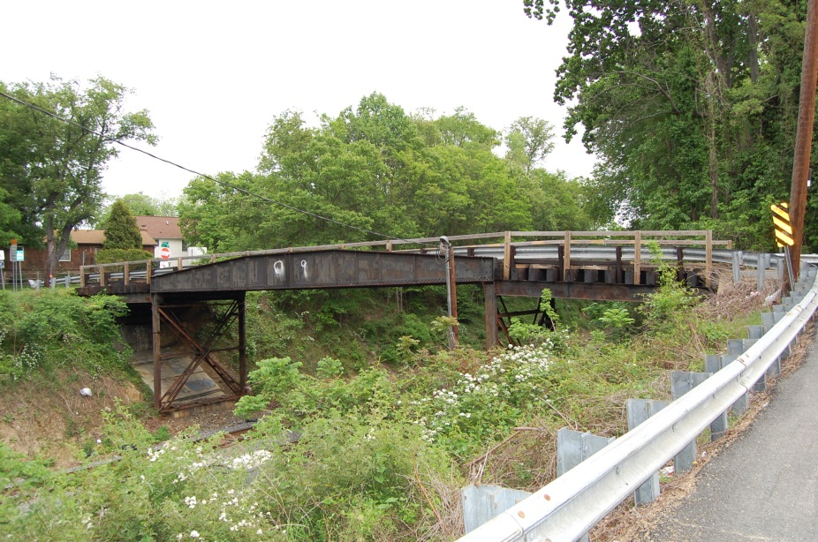
Sector Plan Basics reiterated
What it can do…
What it cannot do…
Define a community vision
Analyze zoning, transportation, community facilities, environmental assets, and historic structures
Make recommendations to preserve, enhance, transform certain physical elements
Serve as a guide when development projects are submitted
Encourage cooperation amongst stakeholders
Code enforcement
Ensure immediate redevelopment
Require adjacent property owners to consolidate
Fund capital improvement projects
1

Slide 10
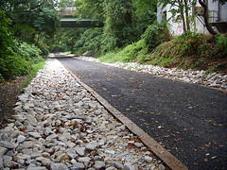
Full Schedule
Staff work through January 2015
Planning Board Draft February-June 2015
County Executive Review & Council notice period July-August 2015
Council Hearing September 2015
Council Review October 2015-March 2016
Commission Adoption, SMA April 2016-July 2016
1

Slide 11
Process
Community Visioning Workshops
Community Feedback
Community Feedback
Public Hearing Draft
Preliminary Recommendations
Staff Draft
Stakeholder Meetings
Planning Board Guidance
Planning Board Guidance
Planning Board Hearing
Planning
Staff
Analyses
Planning Board Worksessions
County Executive Review
Planning Board Draft
Adoption
Council Worksessions
County Council Hearing

Slide 12
Community Visioning Workshops
Community Feedback
Community Feedback
Public Hearing Draft
Preliminary Recommendations
Staff Draft
Stakeholder Meetings
Stakeholder Meetings
Planning Board Guidance
Planning Board Guidance
Planning Board Hearing
Planning
Staff
Analyses
Planning Staff Analysis
Planning Board Worksessions
County Executive Review
Planning Board Draft
Adoption
Council Worksessions
County Council Hearing

Slide 13
Outreach - Where We’ve Been
7/19/12: Scope of Work Approved
5/6/14: Relaunch Meeting, Briefing Book
June 2014: Monday Matters Series
7/15/14: Community Workshop #1
1

Slide 14
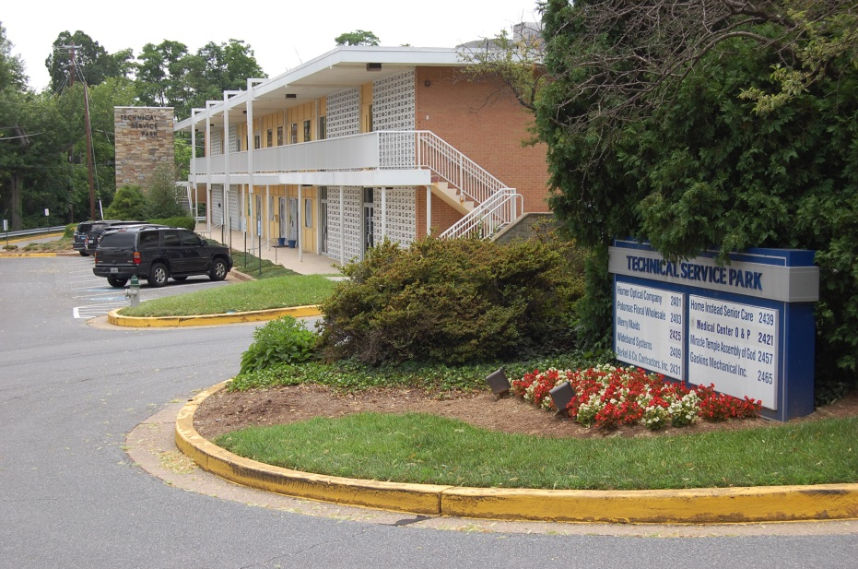
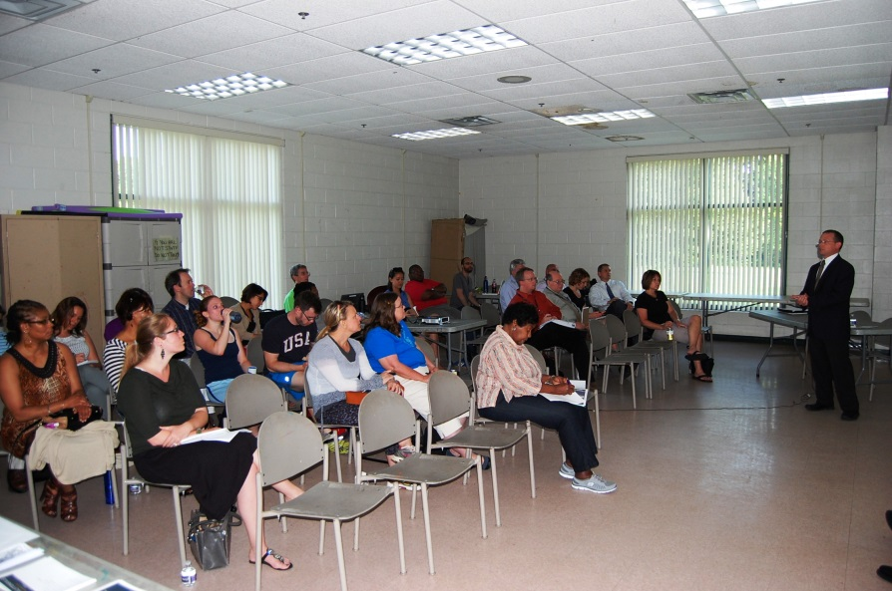
Outreach - Next Steps
Late July/early August: Brookville Road area Business Breakfasts
8/5/14: National Night Out
Fall 2014: Community Workshops #2 & #3
Civic Groups & Community Events
1

Slide 15
Workshop #1 – Tonight’s Purpose
Objective: Further discuss existing conditions, opportunities, and constraints within the Sector Plan area.
Goal: Understand issues that exist today in order to make informed decisions about the future.
1

Slide 16
Breakout Groups - Instructions
Friendly neighbors & sense of community
Missing sidewalk sections on Brookville Rd
1

Slide 17
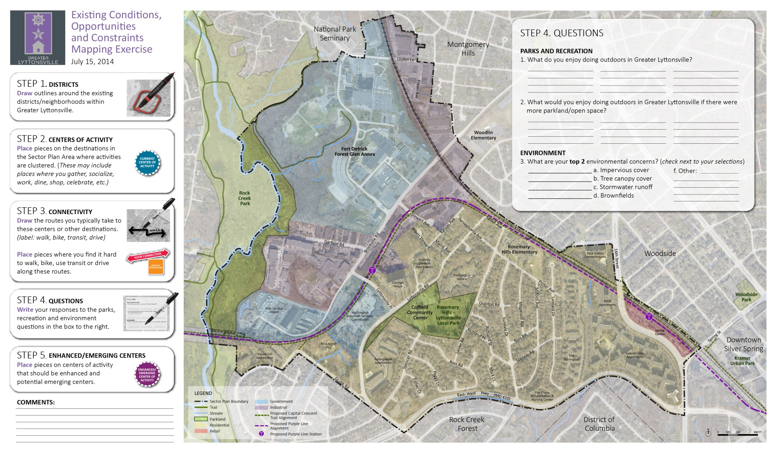
Breakout Groups - Instructions
Playing soccer on Wed.
nights
Walk
1

Slide 18
#greaterLP
Proposed Methods
Public meetings
Workshops and Focus Groups
Forums
Social Media
Community Events
Connect with us via:
Twitter - @greaterLP
Email – greaterlp@montgomeryplanning.org
1

