Slide 1
Work Session 1 l Planning Board March 24, 2016
Notes:
This is the first Work Session for the Greater Lyttonsville Plan. Today we will be sharing more details about Greater Lyttonsville’s unique land use and zoning history, followed by a macro-level discussion of Staff’s Zoning Approach in the Sector Plan with the intention of a site-by-site analysis in Work Session #2, and then we will share Affordable Housing data with the Board and Staff’s conclusions.

Slide 2
Tentative Schedule
March 24, 2016 Work Session #1: History, Zoning Approach, Affordable Housing
April 14, 2016 Work Session #2: Site by Site Zoning Analysis
May 19, 2016 Work Session #3: Transportation, Schools, Parks & Open Space
June 2, 2016 Final Edits/Planning Board Vote Out
Notes:
The framework for this sector plan is to preserve, enhance, and expand the core strengths of Greater Lyttonsville. There are many great assets worthy of protection, including the rich history that Sandra discussed, as well as the employment areas off of Brookville Rd, the established residential neighborhoods, and the opportunities for affordable housing.
But we’re also looking to enhance the pedestrian experience which is lacking in certain places, provide more environmental benefits through redevelopment that will have to meet much more stringent requirements than the current structures had to meet, and use zoning designations that will allow retail that supports employees and residents.
When it comes to expansion, we’re trying to recognize and manage the change that inevitably follow construction of the Purple Line, so the mixed use zoning recommended near the stations allows for a mix of infill and new construction near the stations and our transportation recommendations look to ease access to the employment areas in the Plan. There are new parks and open spaces that are also recommended to serve existing and new residents.

Slide 3
Greater Lyttonsville’s Rich History

Slide 4
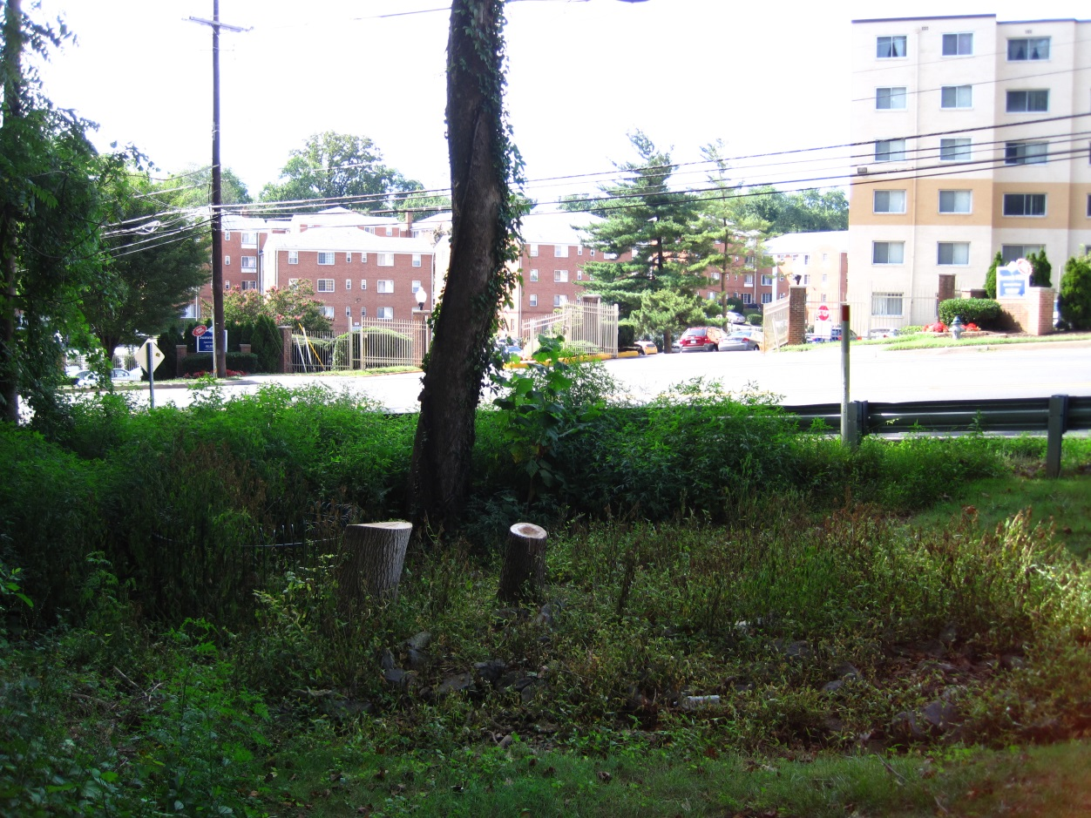
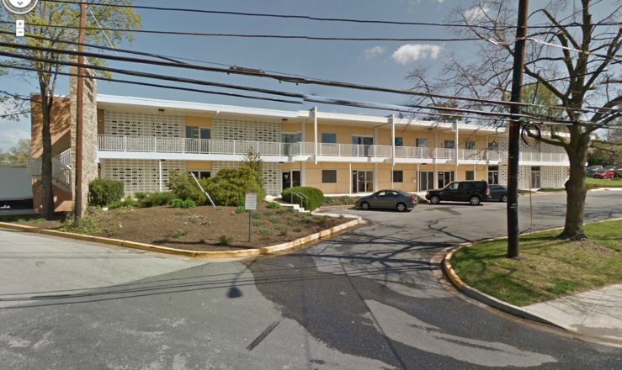
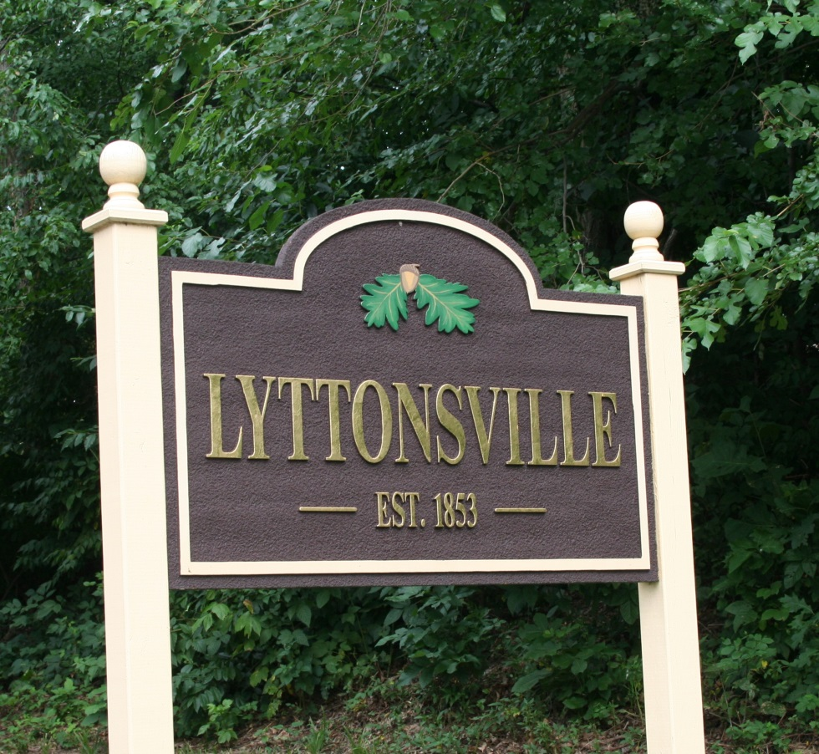
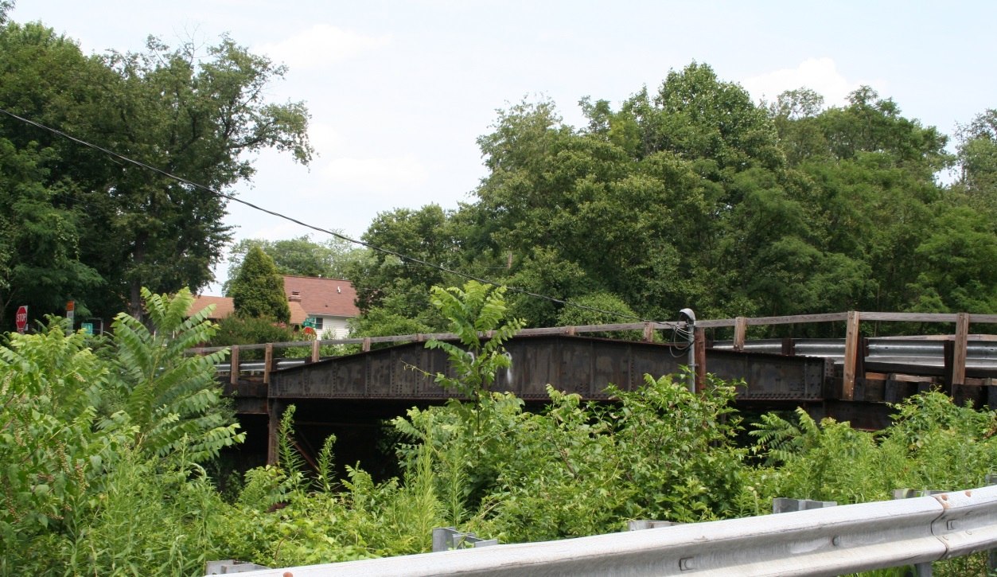
Many land use and development trends

Slide 5
Land Use Chronology
Pre-18th C – use of land for hunting, camping, and quarrying by local and non-local native groups
Late 17th C to Late 18th C – land grants, tobacco cultivation, colonial planters and founding fathers, slavery, ceding of land for new District of Columbia
19th C – soil depletion, smaller farms, agricultural innovation, slavery, free black settlement, Civil War skirmishes, country estates, turnpikes, railroads, trolleys, first suburbs, industrialization, commercial enterprises, schools and churches, nearby villages with post offices
20th C – new roads, auto-oriented development, housing innovation, single-family subdivisions, garden apartments, mid-rise complexes, high-rises, segregation and integration, increasing industrialization and dislocation, county and federal/military facilities, urban renewal, Metro

Slide 6
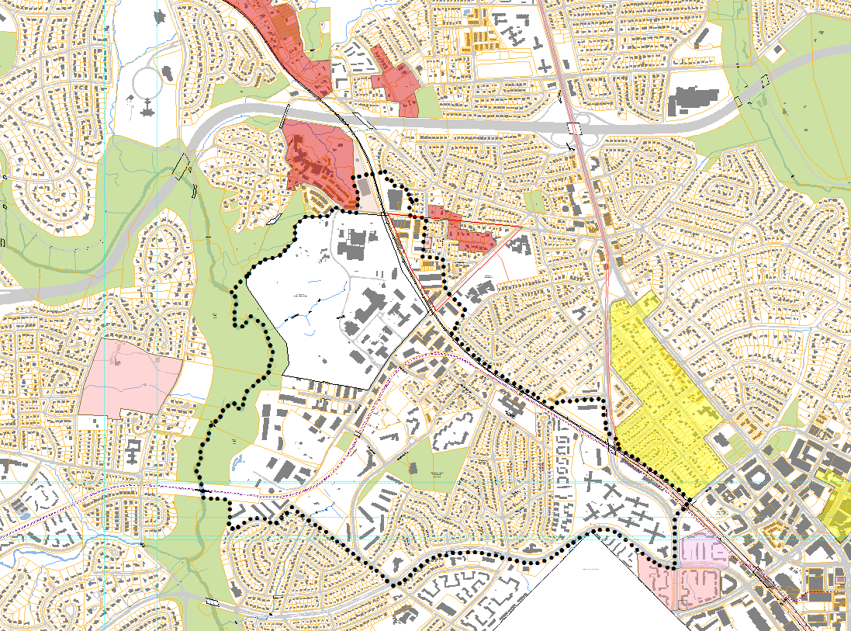
MP – Capitol
View
Park HD
Composite
History
Forest Glen
Invest. Co.
MP – Forest Glen HD
FOREST GLEN TROLLEY STATION
Carroll
Chapel
B&O FOREST GLEN
STATION
The Highlands
MP – National
Park Seminary
HD
Forest
Glen Park
MP –Lawrence House
Carroll
Residence
MP –
Linden HD
WOODSIDE TROLLEY STATION
B&O LINDEN
STATION
Linden
Edgewood
Woodside
MP – Woodend
Perkins &
Burrows
Addition
to Linden
LA –
Woodside HD
The Pilgrim
Church Tract
Clean
Drinking
Manor
Litton-
ville
B&O METROPOLITAN BRANCH
FOREST GLEN TROLLEY
B&O WOODSIDE STATION
B&O GEORGETOWN BRANCH
B&O FENWICK STATION
MP –
DC-MC North Corner Stone
MP – Falkland Apartments
SLIGO TROLLEY STATION
1
Notes:
Greater Lyttonsville Area and Vicinity Historic Resources and Features.

Slide 7
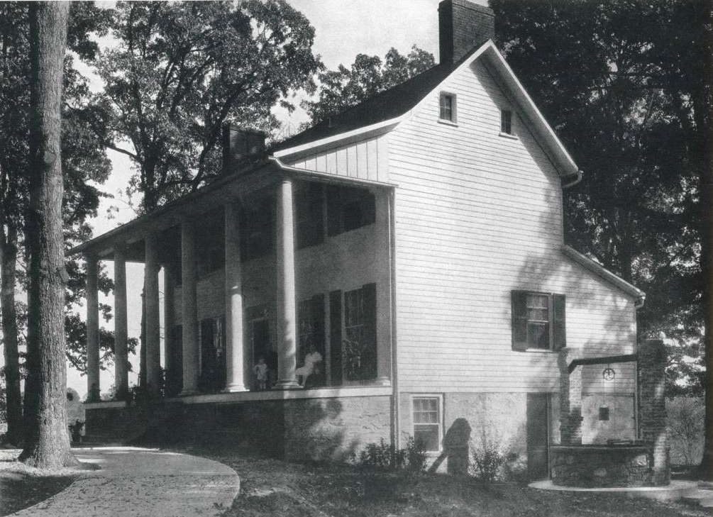
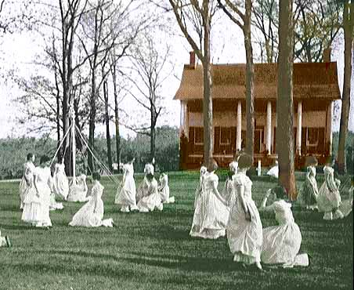
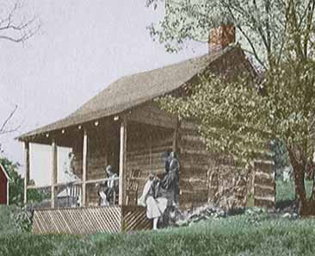
Edgewood Tobacco Plantation
EDGEWOOD, INCLUDING HOUSE, SLAVE CABIN, AND NATIONAL PARK SEMINARY MAYPOLE CEREMONY, NOW FORT DETRICK ANNEX
Sources: Enchanted Forest Glen,
http://www.operant.com/seminary/early_history.html
Notes:
Edgewood, including slave cabin (there were at least 5) and use after purchase by NPS for maypole ceremony (sources Enchanted Forest Glen, http://www.operant.com/seminary/edgewood.html). Became the Forest Glen Annex, then Fort Detrick Annex.

Slide 8
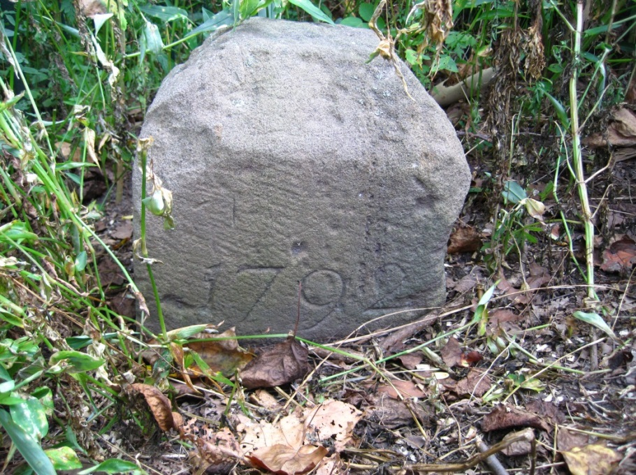
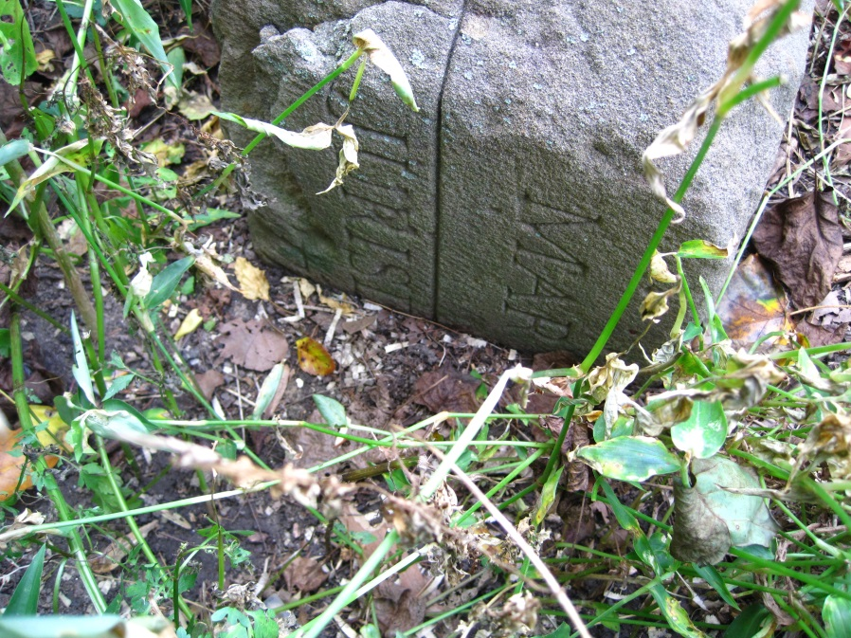
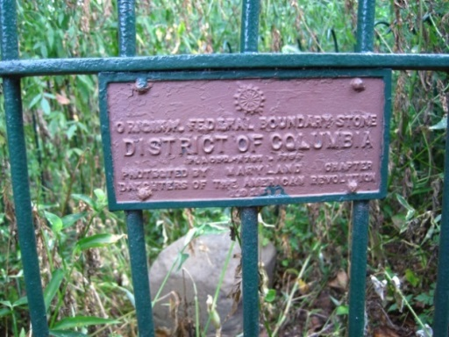
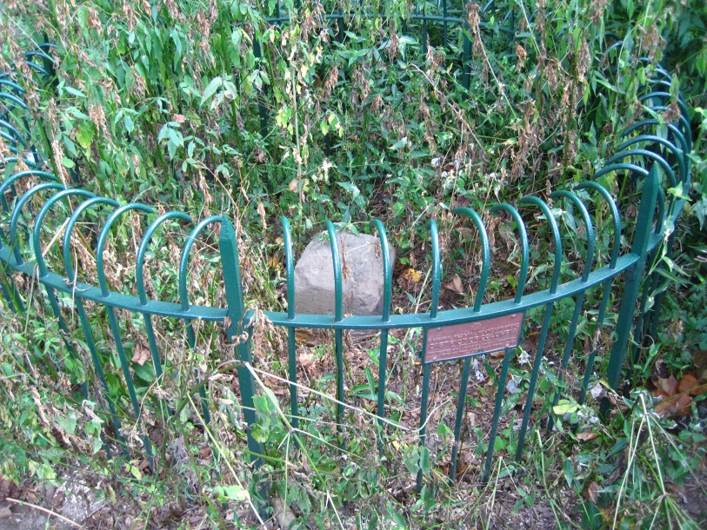
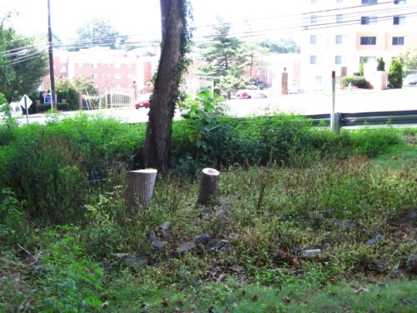
1792 – DC North Cornerstone
BOTTOM RIGHT–
AQUIA CREEK SANDSTONE IN
QUARRY, STAFFORD COUNTY, VA
D.C. NORTH CORNER BOUNDARY STONE
Notes:
DC North Corner Boundary Stone and other DC cornerstones were made of Aquia Creek Sandstone, from a Stafford Co, VA quarry on Wigginton’s Island (now Gov. Island Park and Historic Quarry). In 1791 the Brent family sold the quarry to the Federal Government at the request of George Washington and Pierre L’enfant to provide building material for the new capital, including the White House. George Brent established this quarry after 1694. Photo bottom right: Wikipedia.

Slide 9
19th C. Farming Losses & Innovations
GLEN
ROSS
DRAWING FOR SEED PLANTER FOR CORN, PATENTED IN 1934 TO HENRY BLAIR, “A FREE MAN OF COLOUR,” OF GLEN ROSS, MONTGOMERY COUNTY, MD. BLAIR ALSO PATENTED A SEED PLANTER FOR CORN IN 1836 AND WAS THE SECOND BLACK PERSON TO RECEIVE A U.S. PATENT.
GLEN ROSS WAS THE NAME OF THE 19TH C. ROSS/CISSELL/CHILDS FARM, WITHIN TODAY’S NORTH WOODSIDE AND LYTTONSVILLE. GLEN ROSS IS A NOW A STREET NAME IN NORTH WOODSIDE .
Notes:
19th C Pre Civil War -- Soil Depletion, population loss, continued farming with diversified crops, establishment of country estates, agricultural advances including patents for corn and cotton planters by local African American Henry Blair of Glen Ross (farm near eventual Lyttonsville).

Slide 10
1853 Samuel Lytton’s Land Purchase
Samuel Lytton, a free black man, in 1853 purchased over four acres of and on Brookeville Road from white farmer Leonard Johnson. Lytton was listed in the 1850 Census as a black laborer in the nearby home of Francis Preston Blair. Lytton’s land became the nucleus of a free black settlement.
SAMUEL LYTTON’S PROPERTY

Slide 11
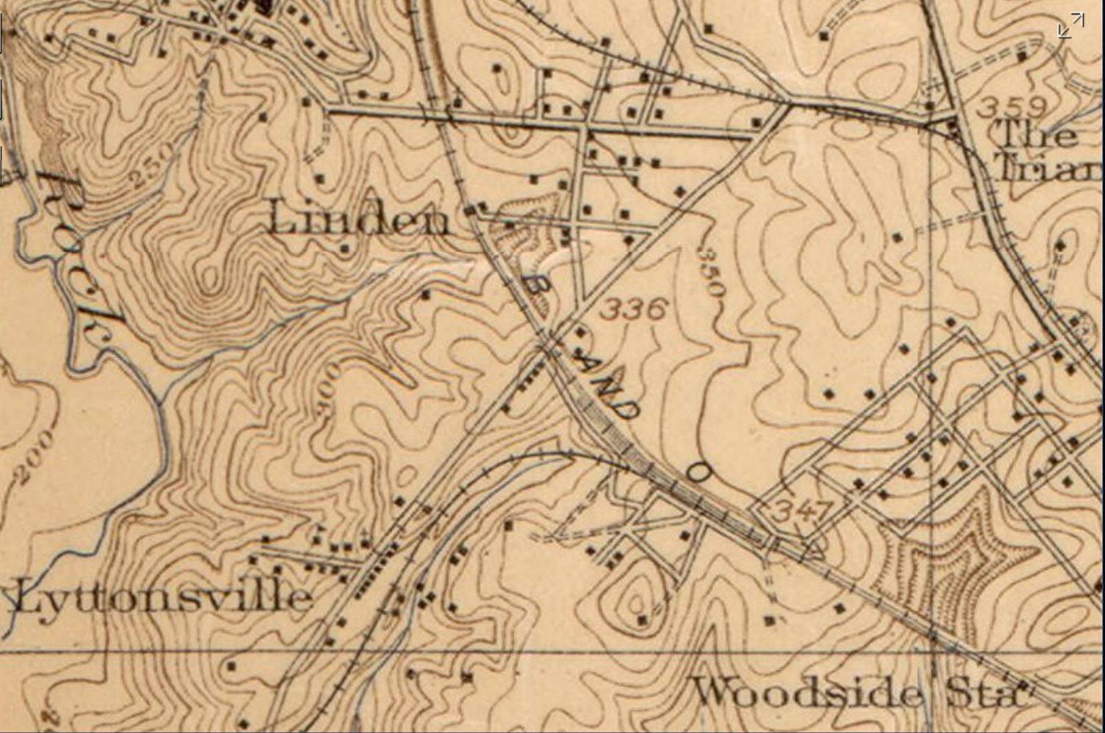
Lyttonsville and Linden 1917
1917 USGS
Notes:
Note trolley line and both railroad lines.

Slide 12
Georgetown Branch, 1972 View
GP9 #6484 PASSING WESTBOUND THROUGH LYTTONSVILLE (APR 1972)
Source: Wm. Duvall Collecition,
at
http://sluggyjunx.com/rr/georgetown_branch/gallery/2004_11_29-wm_duvall_collection/index.html
Notes:
Wm Duvall Collection, GP9 #6484 passing westbound through Lyttonsville. (Apr 1972) Brookville Rd. in the background. Reporting Marks: C-2177, SOO LINE 13587, ANN ARBOR, GN, FGE, FGE, ?, ?, ?,

Slide 13
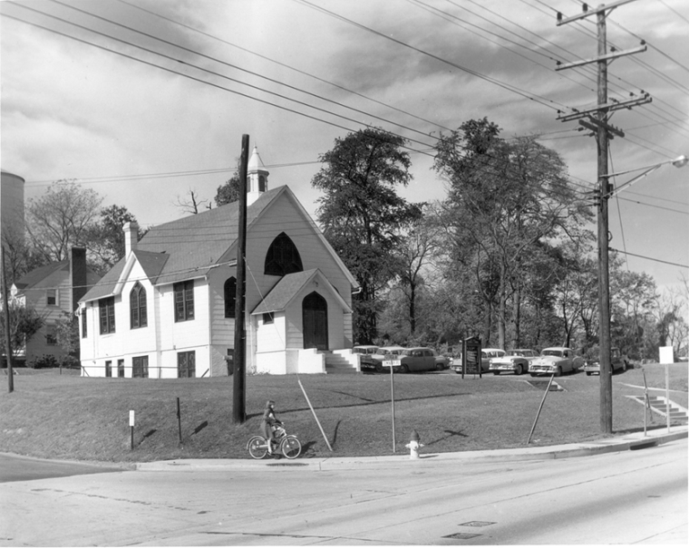
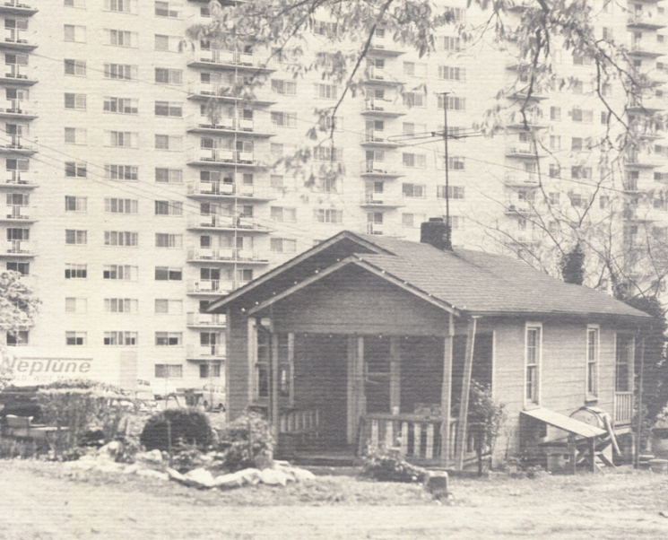
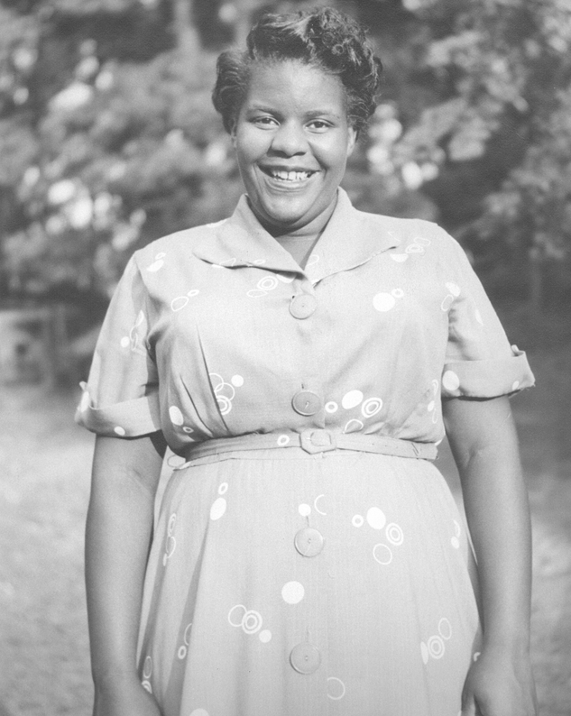
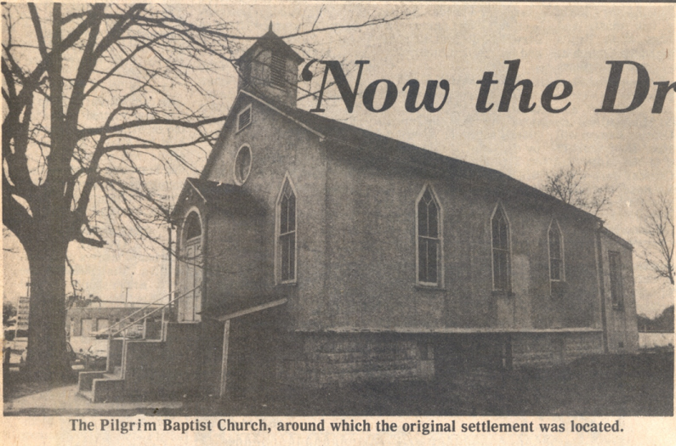
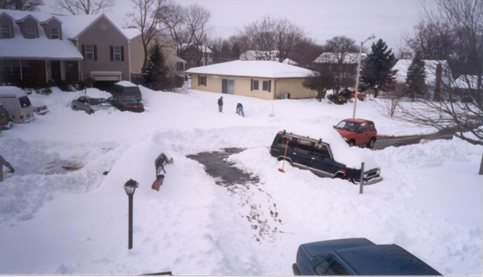
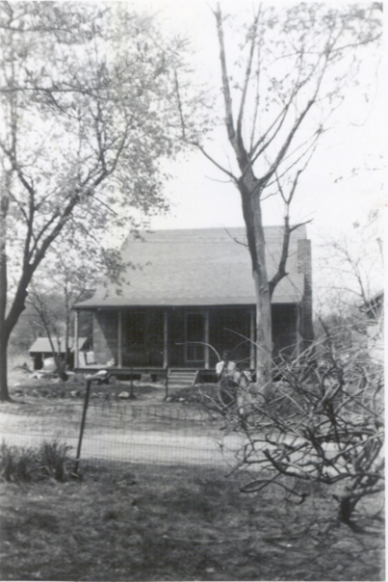
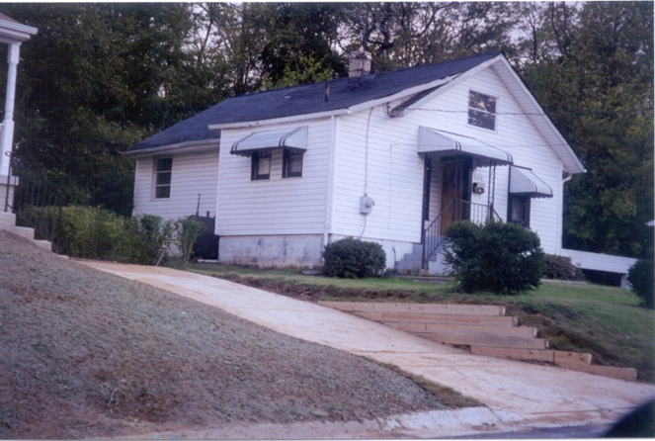
Lyttonsville Then and Now
Notes:
Linden School started in 1896 in the Pilgrim Church. New school built in 1917 on Garfield. Closed in 1955.

Slide 14
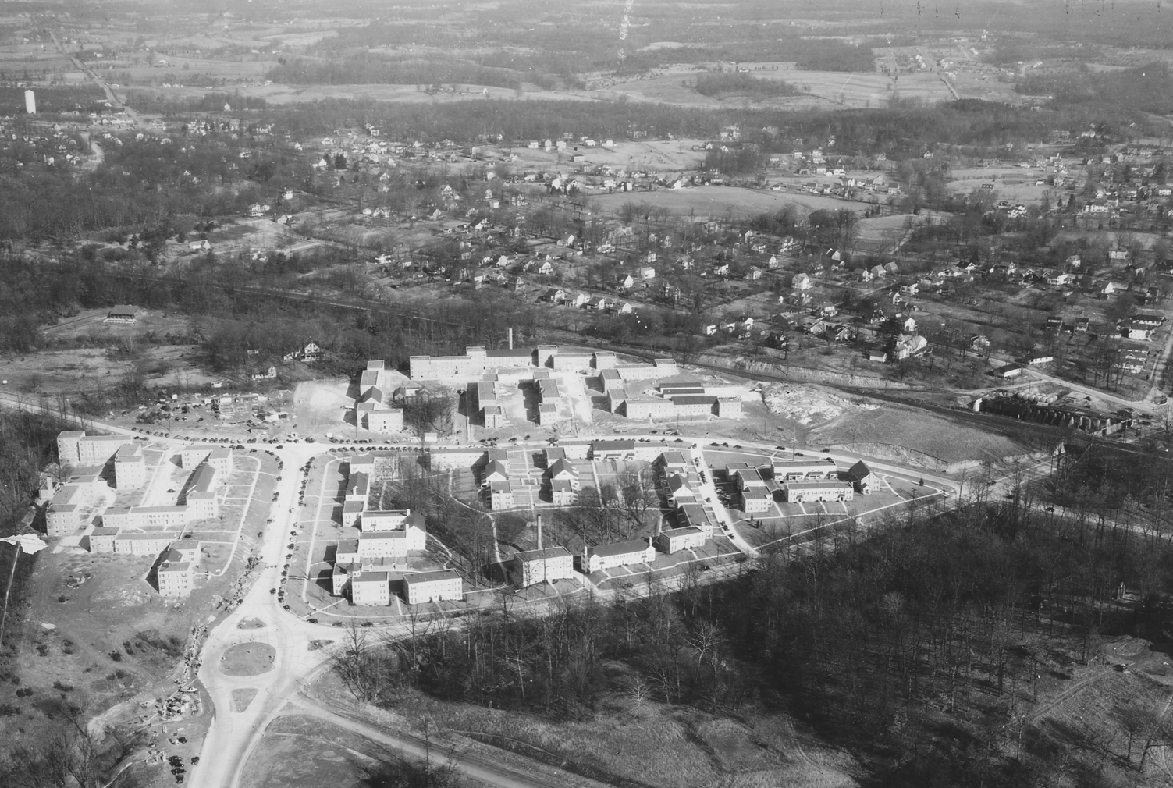
Falklands – Early Garden Apartments
1938, MNCPPC Files
Notes:
Falklands 1938, MNCPPC files, Early Garden Apartments

Slide 15
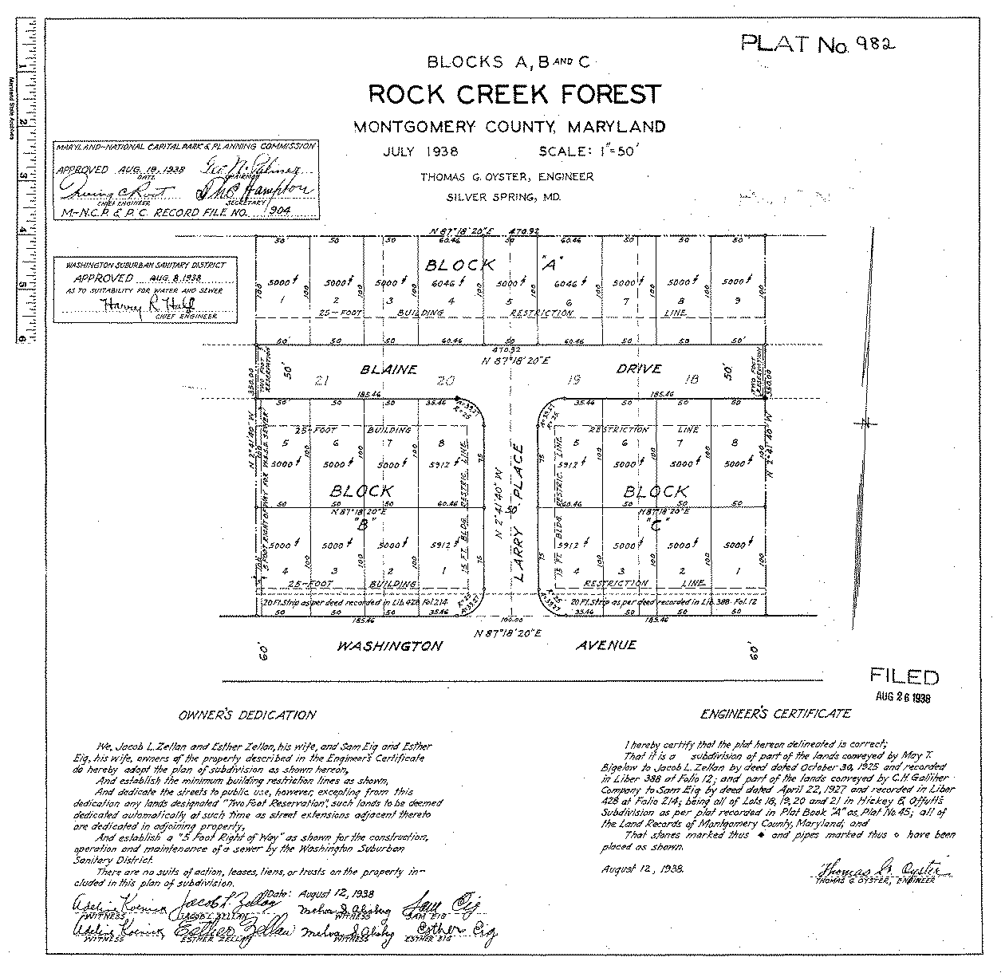
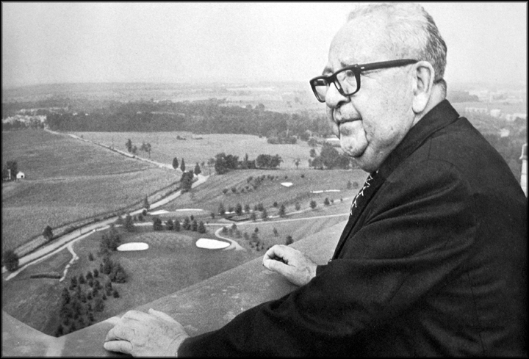
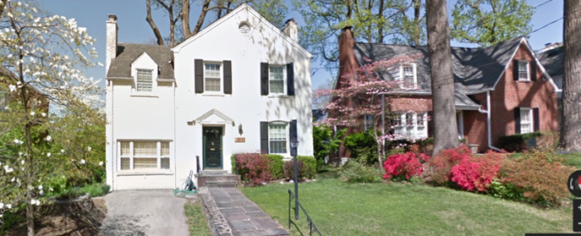
Richland Place Expansibles
SAM EIG REFUSED DEED RESTRICTIONS, GAVE LAND FOR JEWISH CTR & TWO CHURCHES
Notes:
Deed Restriction, excerpt Deed 676/243, 8.6.1937, for 2905 Daniel Rd, Ridgewood Village (from Ridgewood Village to Hazel P. Talbert); Sam Eig built nearby Rock Creek Forest without restrictive covenants, and provided land for a Jewish Community Center, Catholic Church, Protestant Church, and the Red Cross – in order to build a community, not just houses. He recalled that he was urged to make Rock Creek Forest restrictive to increase profits, but he refused. Photo 2805 Blaine Dr (Block A, Lot 2 in Rock Creek Forest, Sterling residence)

Slide 16
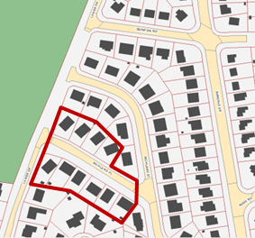
Richland Place Expansibles
Richland Place (1950s “expansibles”) – possible future historic designation or National Register evaluation
Notes:
1951 Richland Place modernist homes, designed by Joseph Miller, developed by Bert Tracy

Slide 17
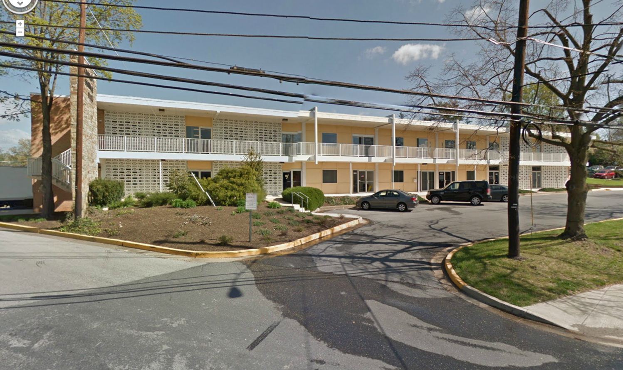
Industrial Development
Technical Services Park, 2415 Linden Lane , built in the mid 1960s to remedy industrial blight
Notes:
Technical Services Park, Mid 1960s

Slide 18
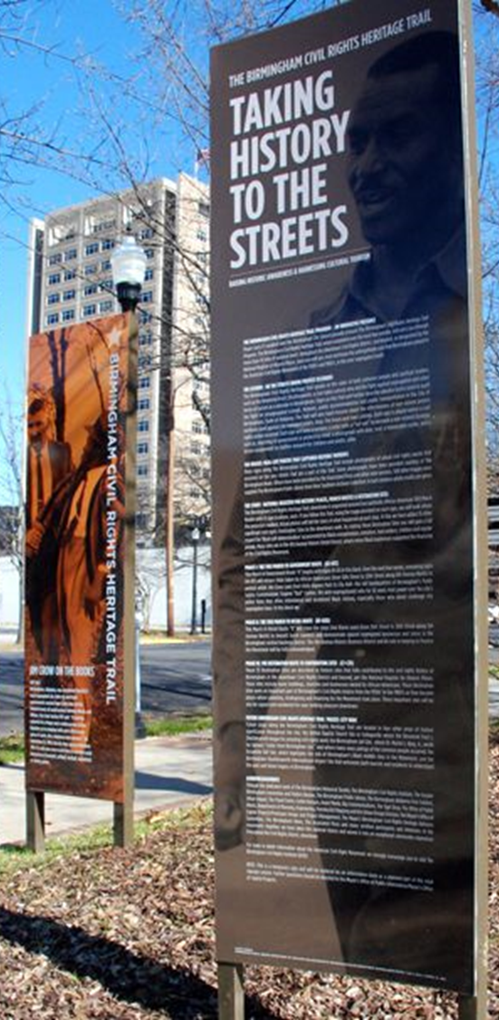
History Recommendations
Promote area history
Erect signage, markers, and commemorative art about local history within the Plan area and Purple Line stations
Establish a history and art implementation committee
Establish a Lyttonsville museum/interpretive space in the Plan area
Conduct a future historic evaluation of the area’s 20th century resources, including Richland Place

Slide 19
Zoning Approach

Slide 20
Framework
Preserve
-Rich History
-Employment Areas
-Established residential neighborhoods
-Housing Affordability
Enhance
-Industrial area presence and operations
-Pedestrian experience
-Environmental benefits
-Neighborhood-serving retail opportunities
Expand
-Opportunities for development near proposed Purple Line stations
-Access to employment centers
-Parks and open spaces
Notes:
The framework for this sector plan is to preserve, enhance, and expand the core strengths of Greater Lyttonsville. There are many great assets worthy of protection, including the rich history that Sandra discussed, as well as the employment areas off of Brookville Rd, the established residential neighborhoods, and the opportunities for affordable housing.
But we’re also looking to enhance the pedestrian experience which is lacking in certain places, provide more environmental benefits through redevelopment that will have to meet much more stringent requirements than the current structures had to meet, and use zoning designations that will allow retail that supports employees and residents.
When it comes to expansion, we’re trying to recognize and manage the change that inevitably follow construction of the Purple Line, so the mixed use zoning recommended near the stations allows for a mix of infill and new construction near the stations and our transportation recommendations look to ease access to the employment areas in the Plan. There are new parks and open spaces that are also recommended to serve existing and new residents.

Slide 21
Recommendations
Create more logical industrial and residential areas, increase compatibility
Stability for single family detached zones and institutional sites
Preserve majority of industrial area, but expand retail options through CRT floating zone
Zoning changes to CR Zones primarily on sites currently zoned for multi-family residential
Notes:
In order to implement this framework, these are the major zoning themes in the Sector Plan

Slide 22
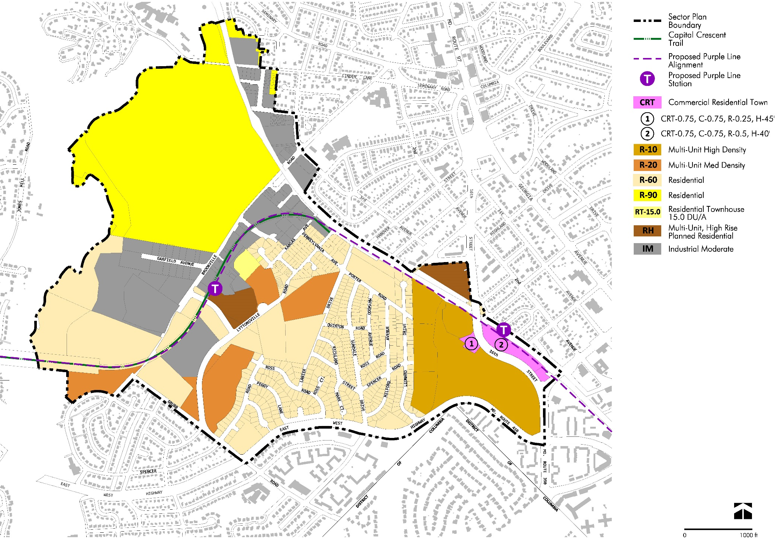
Zoning - existing
0.4 FAR
0.5
FAR
0.62 FAR
1.2 FAR
0.46 FAR
0.21 FAR
0.40
FAR
1.0 FAR
Notes:
This map shows the existing zoning and the FARs on the properties where we are recommending zoning changes.

Slide 23
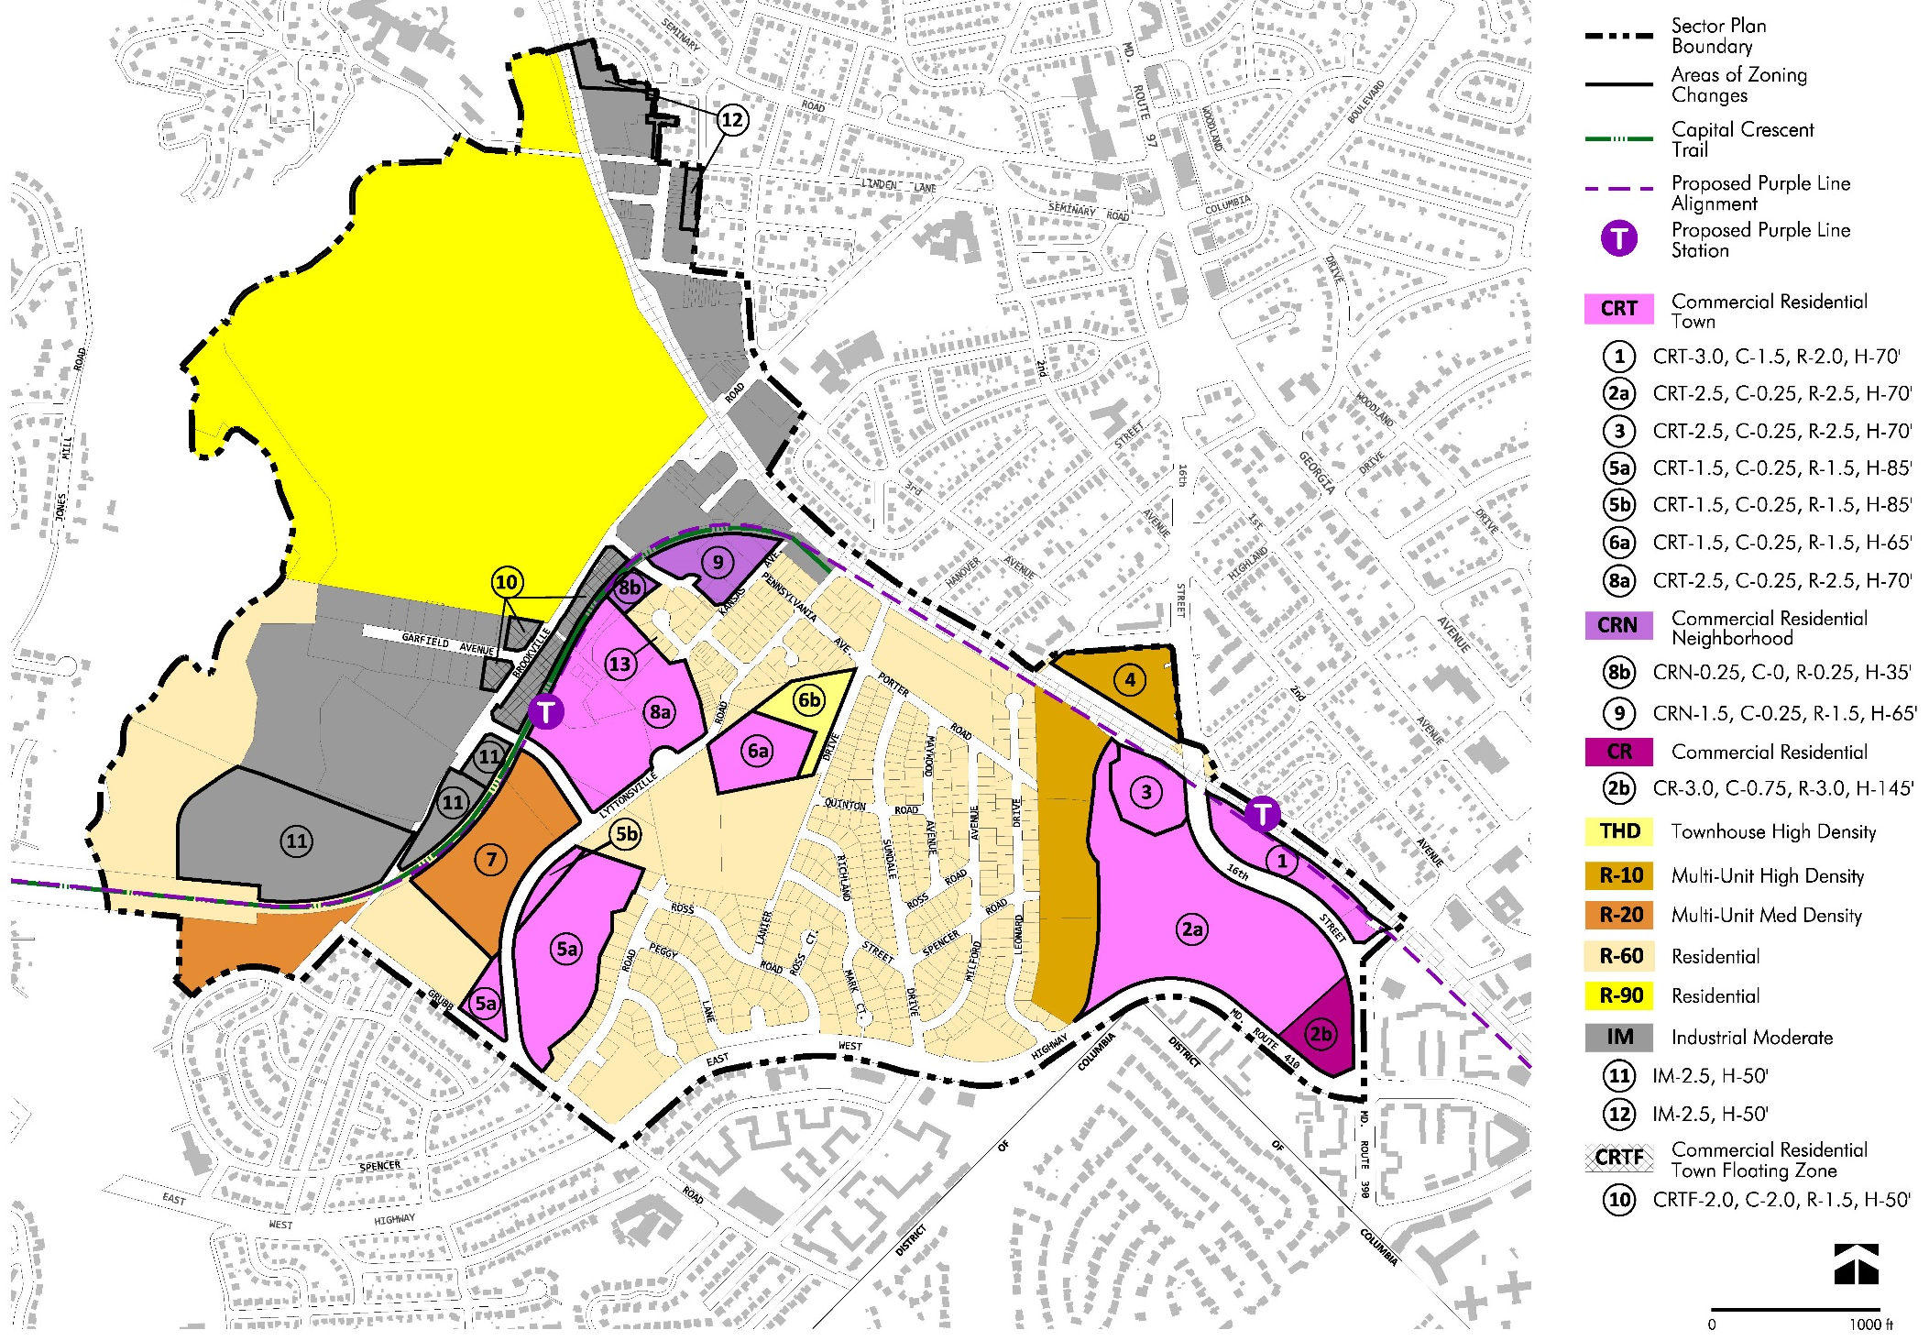
Zoning - proposed
Range:
1.0 – 2.5 FAR
65-85 ft Height
Range:
2.5 – 3.0 FAR
70-140 ft Height
Notes:
FARs around Lyttonsville Station range from 1.0-2.5 with recommended building heights between 65 and 85 feet.
FARs around 16th St/Woodside Station ranging from 2.5-3.0, with recommended building heights between 70 and 145 feet.

Slide 24
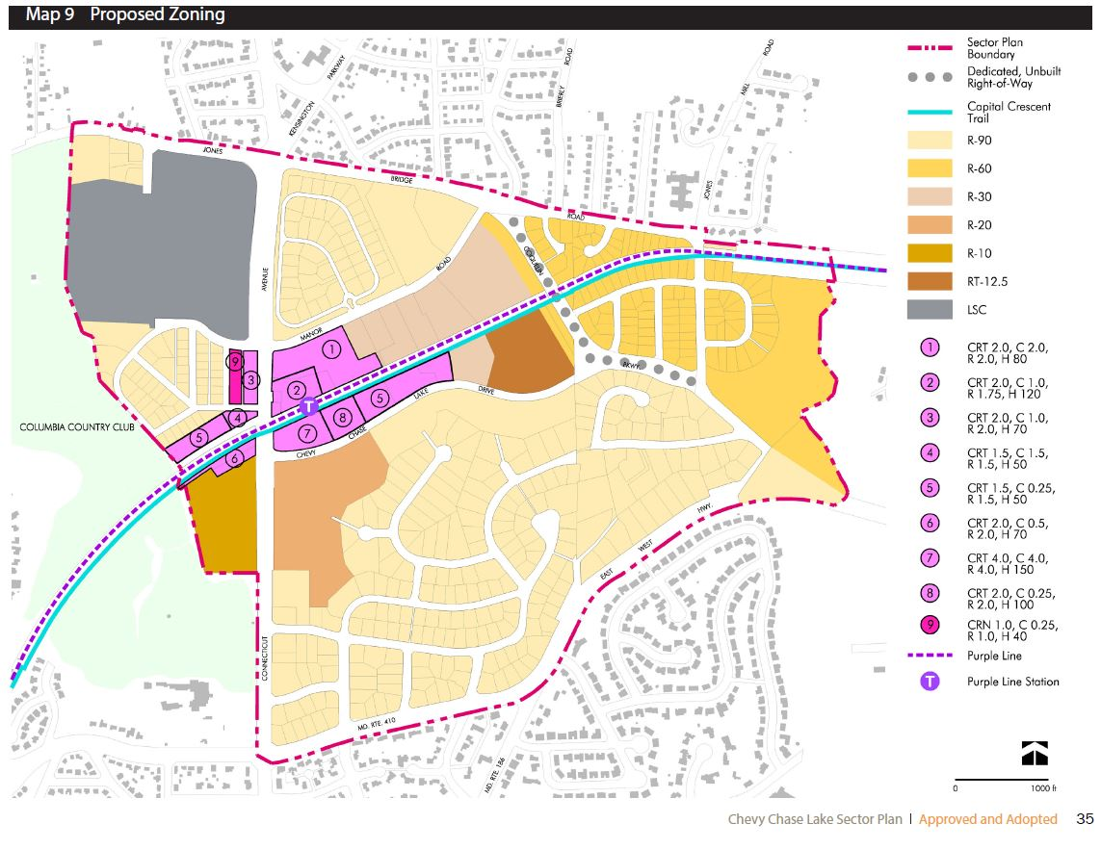
Connecticut Avenue Station
Range:
1.5 – 4.0 FAR
50-150 ft
Height

Slide 25
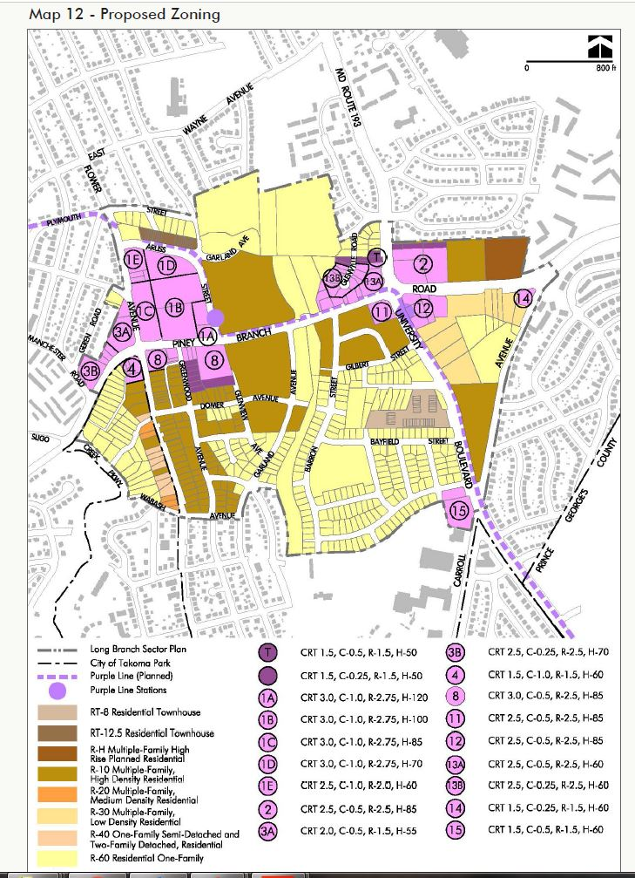
Long Branch Station
Range:
1.5 – 3.0 FAR
50-150 ft Height

Slide 26
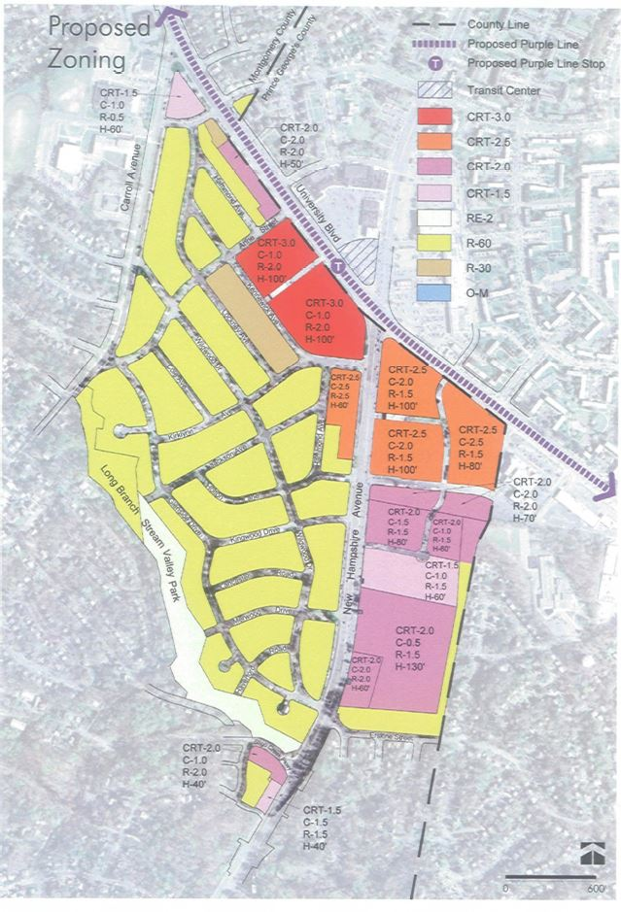
Takoma/Langley Station
Range:
1.5 – 3.0 FAR
60-130 ft Height

Slide 27
Current Industrial Zoning
Existing properties zoned industrial
(orange):
80 acres

Slide 28
Proposed Industrial Zoning
Properties zoned industrial
after rezonings to CRT, CRTF,
CRN, and R-20:
57 acres
Bus depot & parking lots,
rezoned as industrial (striped):
23 acres
Total industrial post-recommendations:
80 acres
Notes:
You can see how the area of industrial zoning is more consolidated and contiguous now. I will let Rick elaborate on how the Sector Plan seeks to strengthen the industrial district

Slide 29
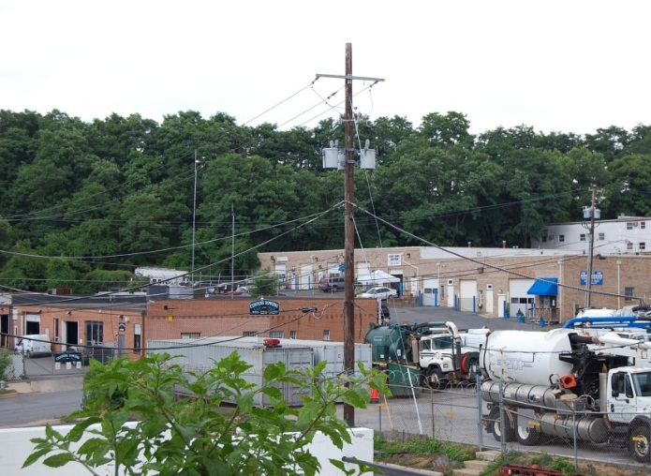
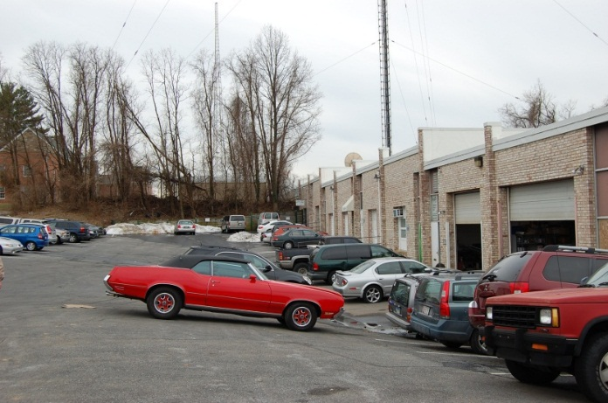
Strengthening the Industrial District
Brookville Road Market Study
Key Questions
Will Purple Line/market forces cause displacement?
Will zoning to non-industrial uses impact the area?
How can we strengthen the industrial district?

Slide 30
Strengthening the Industrial District
Key Findings
Purple Line/Market Forces will NOT singlehandedly cause displacement
Limited commercial demand
Vertical redevelopment is costly
Changes to industrial zoning COULD have limited impact
Avoid rezoning sensitive industrial properties
REINFORCE industrial district presence
Support operational needs
Encourage business attraction & reinvestment

Slide 31
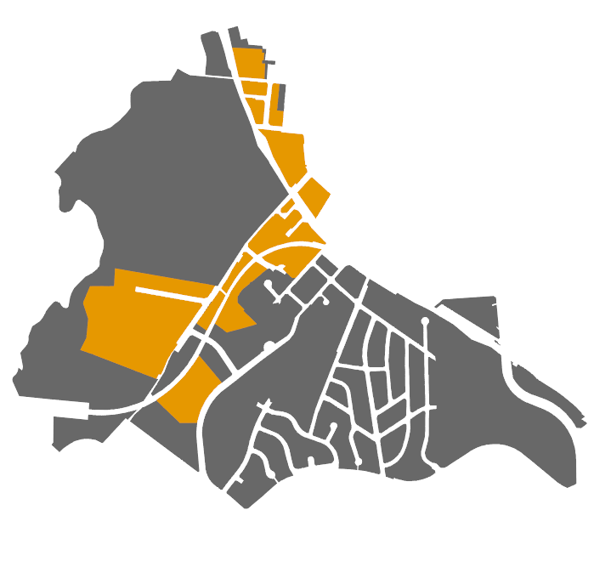
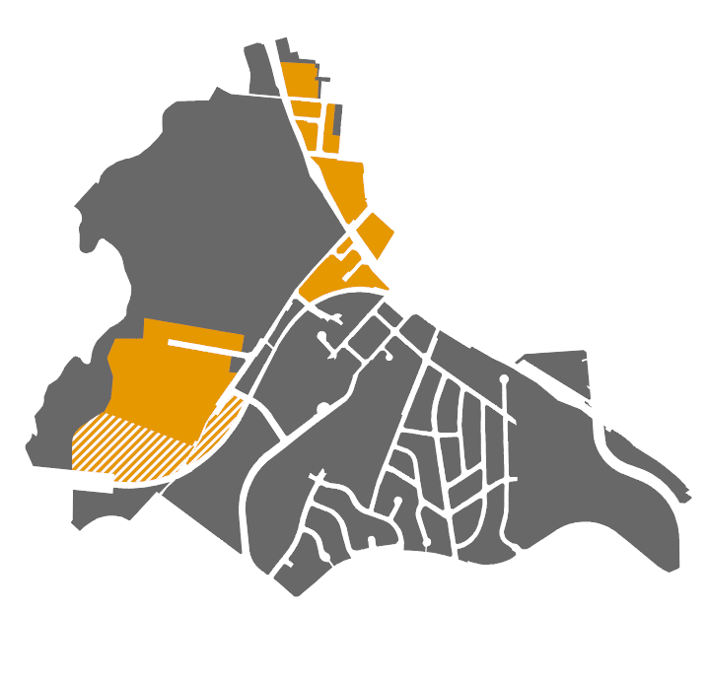
Strengthening the Industrial District
General Strategy
Existing
Preserve majority of industrial area
Avoid CR conversions in most sensitive areas
Improve operations in Industrial District (e.g. wayfinding)
Economic Development – attract businesses, coordinate marketing/branding
Proposed
Notes:
East of purple line tracks, and core properties west of Purple line (floating zone)

Slide 32
District Character & Compatibility

Slide 33
Building Form and Compatibility Goals:
Design buildings and landscape to frame a vibrant public realm of walkable and active streets and public spaces.
Provide opportunities for limited development near the proposed light rail stations that is compatible with surrounding communities.
Notes:
The two primary goals for Building Form and Compatibly outlined in the Community Design section of the Sector Plan are….
The following slides show examples from around the country of design solutions that can be applied in Greater Lyttonsville to achieve these Plan goals

Slide 34
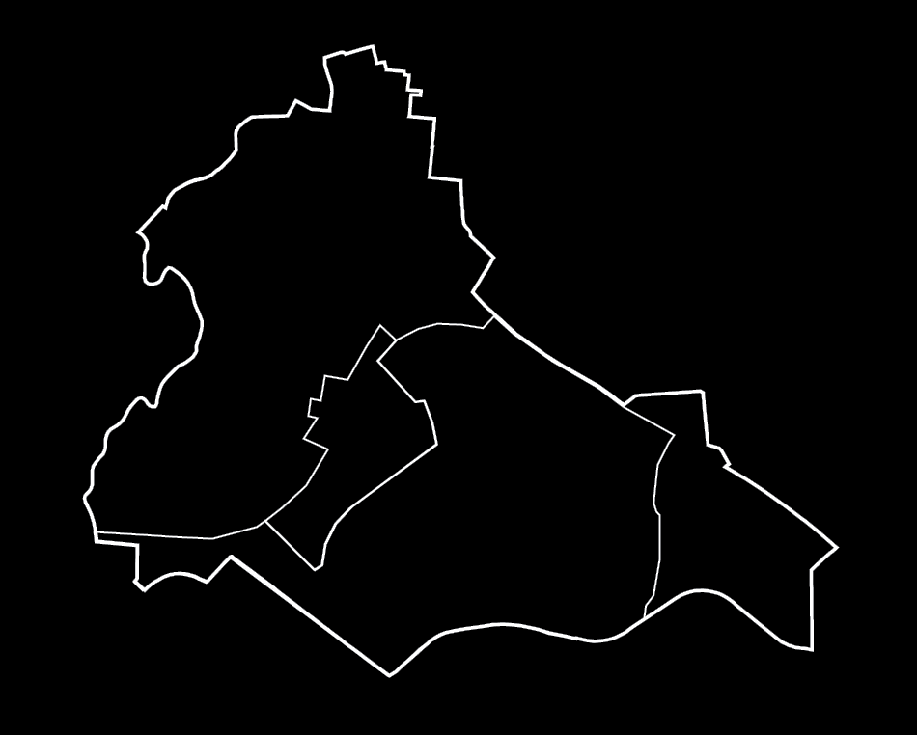
Industrial/Institutional Area
Industrial/ Institutional Area
Brookville Rd/ Lyttonsville Station Area
Residential Area
Woodside/ 16th St Station Area

Slide 35
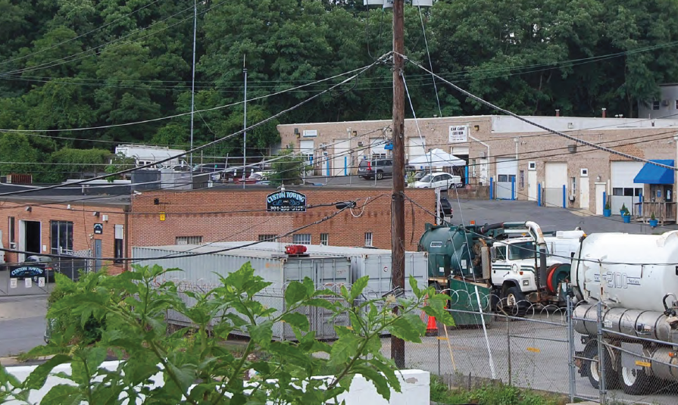
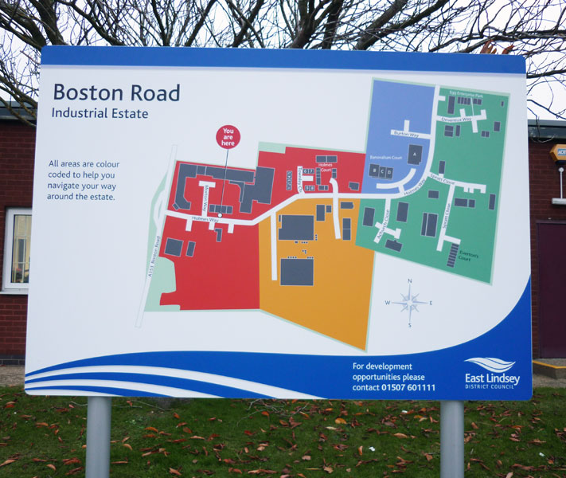
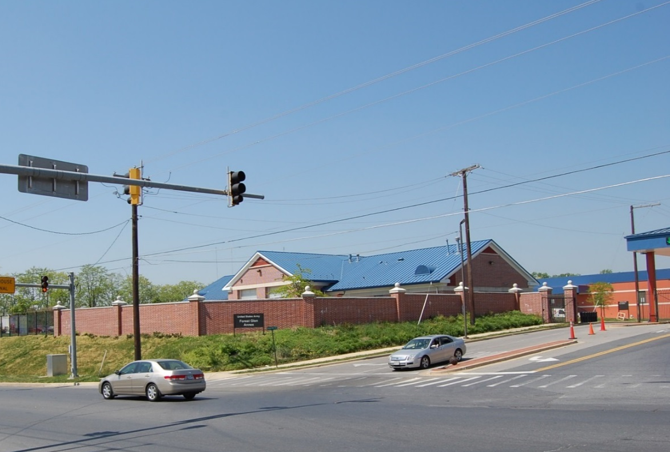
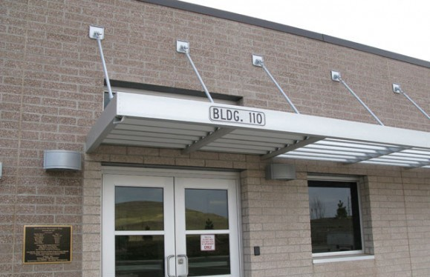
District Character
Notes:
The industrial and institutional area is envisioned to continue to look and function for the most part as it does today. Minor improvements to sidewalks intersections and wayfinding could make it easier for customers and employees to most efficiently use this area that as Rick mentioned previously is a vital resource for the county.

Slide 36
Brookville Road/Lyttonsville Station Area
Industrial/ Institutional Area
Residential Area
Woodside/ 16th St Station Area

Slide 37
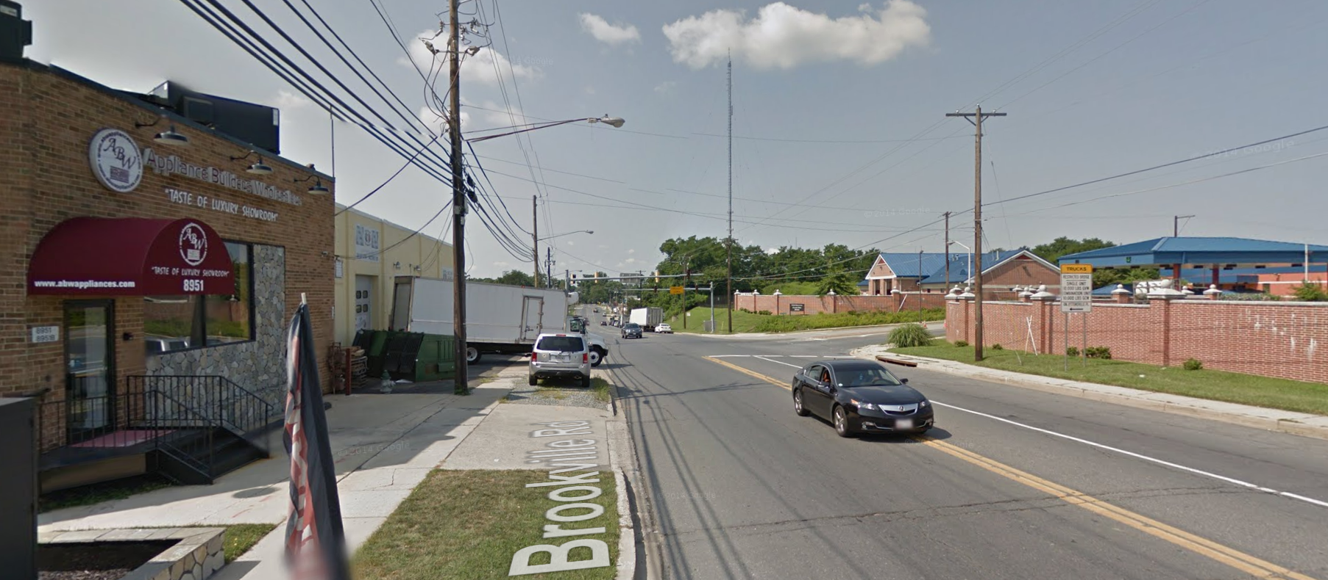
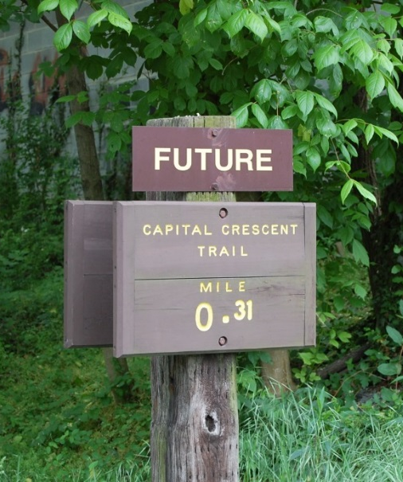
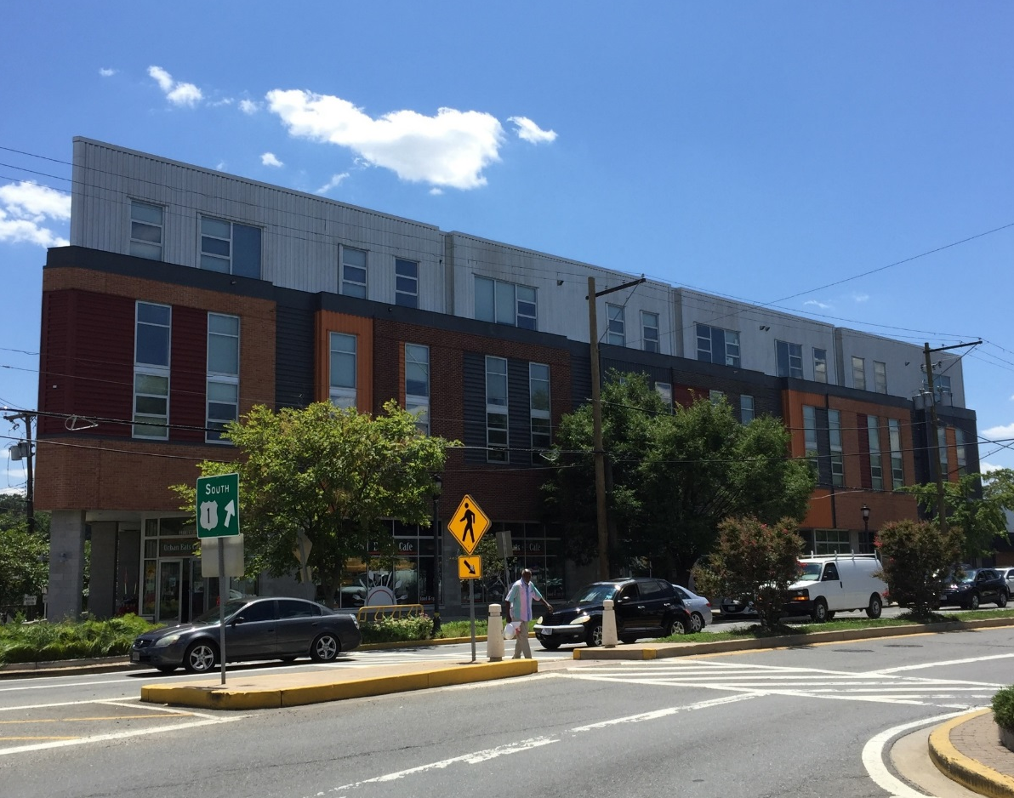
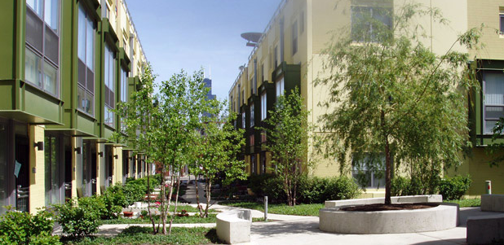
District Character
Notes:
Moving east, the Brookville Road Lyttonsville station area today is where many different uses meet including commercial and industrial businesses, as well as institutional and residential uses. The plan would like to continue to support this mix of uses and to provide new opportunities for transit-oriented infill development in close proximity to the new purple line station.
This potential development will have distinct character on each side of the tracks. Along Brookville road any infill development should be low rise and merge with the corridors industrial character. Southeast of the tracks new open space opportunities along the Capital Crescent Trail and primarily residential midrise development will help better link the residential area to the station and the potential emerging center along Brookville Road.

Slide 38
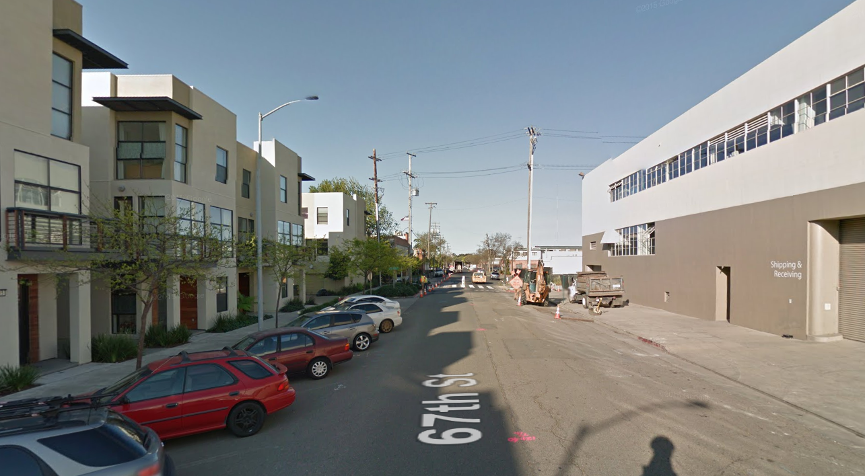
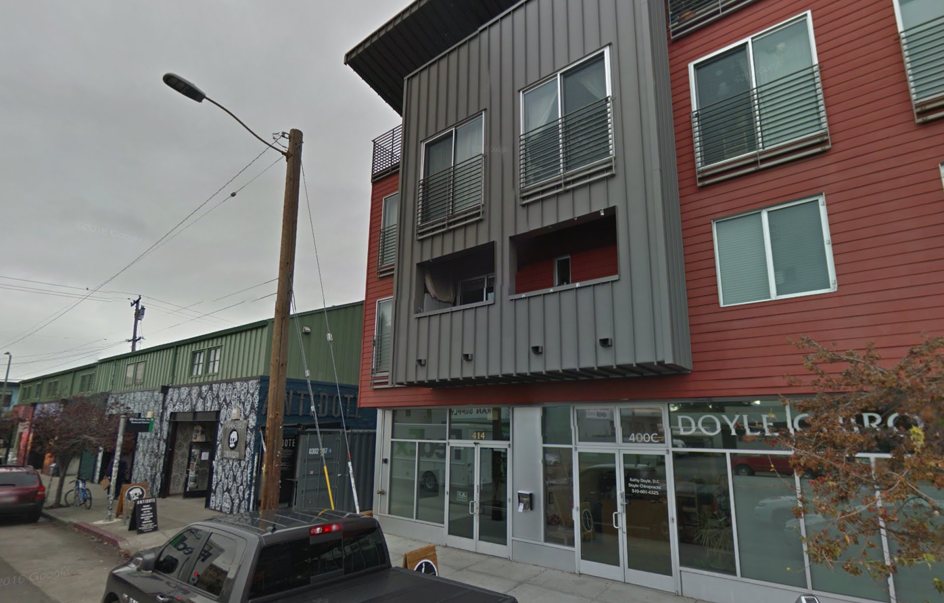
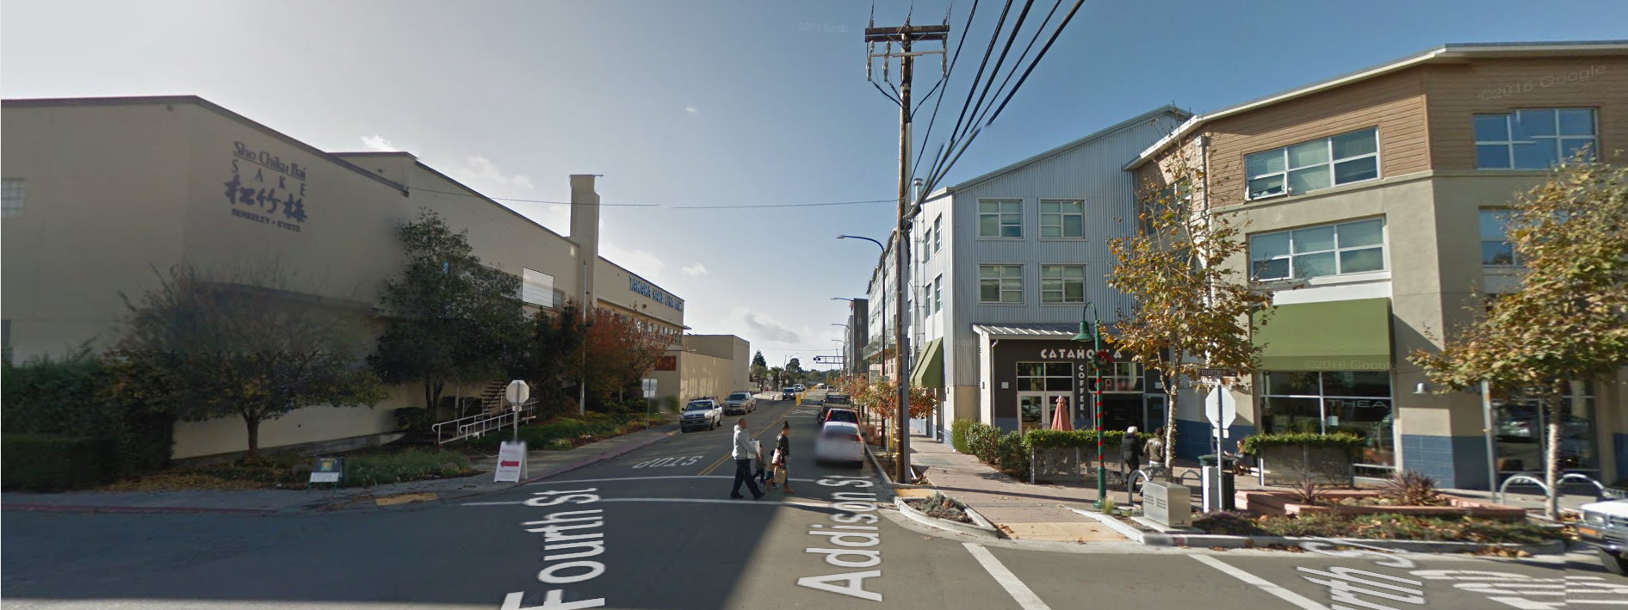
Where Industrial meets Residential/Mixed Use
Emeryville, CA
Oakland, CA
Berkeley, CA
Notes:
As we consider the compatibility of residential and industrial uses in terms of design along Brookville Road, these areas in the East Bay in California show that residential mixed use development can reside adjacent to industrial uses and maintain a similar lowrise scale and design language.
As seen in the top left image, streetscape improvements adjacent to the residential uses foster pedestrian comfort and do not have to continue on the industrial frontages where they may impede truck traffic access and loading.

Slide 39
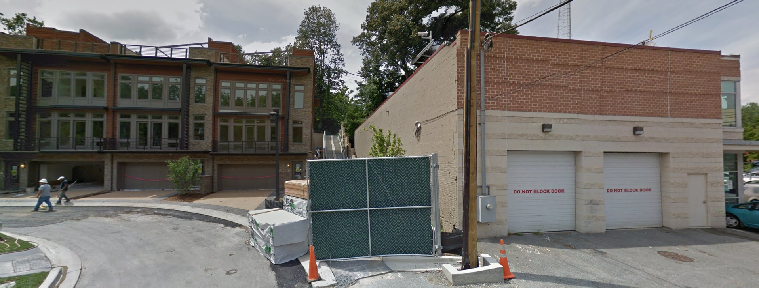
Where Industrial meets Residential/Mixed Use
Little Falls Place, Westbard
Notes:
And closer to home here in Westbard you are all aware of the Little Falls Place townhome development directly adjacent to industrial uses where again the scale and design language of the new townhouse development merges well with the industrial character and context.

Slide 40
Light Rail Scale in Edge Communities
Mount Royal Station, Baltimore, MD
Raymond Ave Station, St. Paul, MN
Notes:
For character on the other side of the Purple Line tracks, we can take a look at the scale of new development in communities adjacent to lightrail but outside of the central business district. Here we see buildings at a midrise scale of 4-6 stories similar to what is envisioned for the 16th Street and Lyttonsville Station Areas.

Slide 41
Light Rail Scale in Edge Communities
East/West Station, Charlotte, NC
New Bern Station, Charlotte, NC
Notes:
This scale and building placement better frames adjacent streets and trails, and creates an inviting and walkable environment near the stations.

Slide 42
Residential Area
Industrial/ Institutional Area
Brookville Rd/ Lyttonsville Station Area
Residential Area
Woodside/ 16th St Station Area

Slide 43
District Character
Notes:
Comprised primarily of established single-family neighborhoods and home to many of the area’s existing community facilities the Residential Area is envisioned to continue to thrive on the assets that have been gained through years of community involvement. The plan recommends public improvements that will make it easier to walk and bike through the neighborhood, and limited development closest to the proposed purple line station that maintains compatibility with adjacent homes.

Slide 44
Compatibility
Lyric Apartments, Seattle, WA
Notes:
Through our discussions with community members there has been strong concern about how buildings of up to 6 stories will interface with the adjacent lowrise and single family areas.
This development in Seattle illustrates how a building can maximize height at one edge as seen in the top photo and be designed to step down to a lower height on the facade facing a single-family area as seen in the photo below. Compatibility is also achieved through finer grain articulation of the building on this edge and individual ground floor entrances.

Slide 45
Compatibility
East/West Station, Charlotte, NC
Notes:
Similarly, these images of the two facades of a project near East/West light rail Station in Charlotte illustrate that on one building face you can have mixed use with multifamily housing and then by lining the other edge of the same building with townhome units and individual entries you can effectively transition to adjacent single family neighborhoods.

Slide 46
Woodside/16th St Station Area
Industrial/ Institutional Area
Brookville Rd/ Lyttonsville Station Area
Residential Area
Woodside/ 16th St Station Area

Slide 47
District Character
Notes:
As a gateway to Downtown Silver Spring and close to the Silver Spring Metro and proposed Purple Line stations, the Woodside/16th street Station Area is well-positioned for walkable transit-oriented development. Currently Spring Center and Summit hills are disconnected from surrounding streets because of large areas of surface parking. Summit Hills in particular—an almost 30 acre site—feels like an internalized gated community. Infill development of portions of the district could better relate to surrounding streets and internal pathways, and combined with improvements to 16th street, could make it a safer area to walk, bike and use transit.

Slide 48
Compatibility through Infill
DelRay Tower Apartments, Alexandria, VA
Notes:
It is important to again emphasize that the Sector Plan recommends increased density on multifamily sites not only to encourage redevelopment, but to also provide the opportunity for rehab and midrise infill development that can better relate to surrounding streets and improve compatibility with adjacent lowrise housing.
This example of the DelRay towers in Alexandria started as a tower surrounded by parking, similar to the scale and configuration of the Claridge House, 8600 Apartments and Summit Hills.

Slide 49
Compatibility through Infill
DelRay Tower Apartments, Alexandria, VA
Notes:
The project removed the building skin while maintaining the existing structure…

Slide 50
Compatibility through Infill
DelRay Tower Apartments, Alexandria, VA
Notes:
…the building was then reskinned and midrise development was infilled that frames the sidewalk and mediates between highrise and adjacent lowrise residential development.

Slide 51
Compatibility through Infill
DelRay Tower Apartments, Alexandria, VA
Notes:
Here is a view from above showing the existing tower perpendicular to Mt. Vernon Ave and the new infill midrise building lining the street with sidewalk improvements. A strategy again that could work well for many of the multifamily properties in Greater Lyttonsville surrounded by parking lots such as Summit Hills, 8600 Apartments and Claridge House.

Slide 52
Affordable Housing

Slide 53
Existing Conditions
Eight rental multi-family developments
All constructed over 40 years ago
2,588 total units (1,091 in Summit Hills)
567 subsidized units, no units currently
in MPDU program
All other units market-rate affordable
at 56-83% AMI
%

Slide 54
Anticipated Preservation or Redevelopment Scenario
Preservation/Infill
Redevelopment

Slide 55
Takeaways
Sector Plan recommendations nearly double number of income restricted units to 1,008 (subsidized and MPDU)
Sector Plan can further expand large unit affordable housing opportunities
- Site specific language
- Prioritize new development that creates balanced bedroom mix
Notes:
Sector Plan recommendations double number of income restricted units 1,029 (567 subsidized + 529 MPDU) income restricted units under redevelopment/infill scenario
Preservation of larger units is desirable (only 12% of larger units are affordable to incomes below 80% AMI) countywide
Site specific language that allows for redevelopment only with the protection, rehabilitation, or creation of larger market-rate, MPDU or subsidized units could be added (Sites 2a, 3, 8a)
Prioritize CR Zone benefit points for new development that creates balanced bedroom mix

Slide 56
Work Session 1 l Planning Board March 24, 2016

