Slide 1
LATR Assessment
Transportation Impact Study
Technical Working Group
(TISTWG)
9/3/14 Meeting Packet

Slide 3
TISTWG
Core Technical Team
MCDOT
Maryland SHA
WMATA
M-NCPPC
Advisory Team
Maryland-National Capital Building Industry Association
Montgomery Civic Federation
Montgomery County Department of Economic Development
Montgomery County Council Staff
Consulting Team
Renaissance Planning Group
Vanasse Hangen Brustlin
VRPA Technologies
Connetics

Slide 4
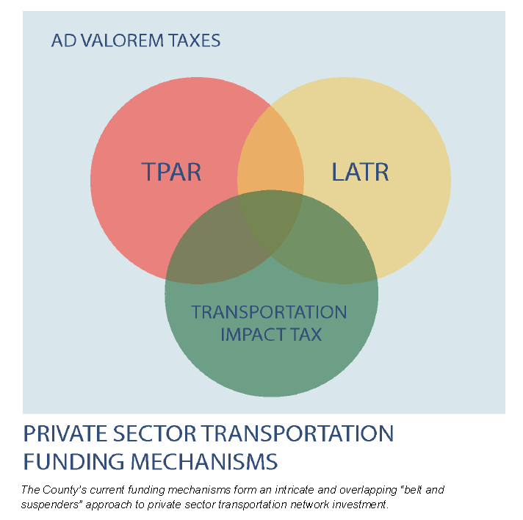
Study Purpose
Focus on Local Area Transportation Review (LATR) technical approaches to balance policy levers
Synthesize concurrent planning and policy study efforts on TPAR and Travel/4 model development, and recent/ongoing planning efforts like White Oak Science Gateway and Bethesda Downtown
Integrate TISTWG interests
Satisfy quadrennial Subdivision Staging Policy requirements

Slide 5
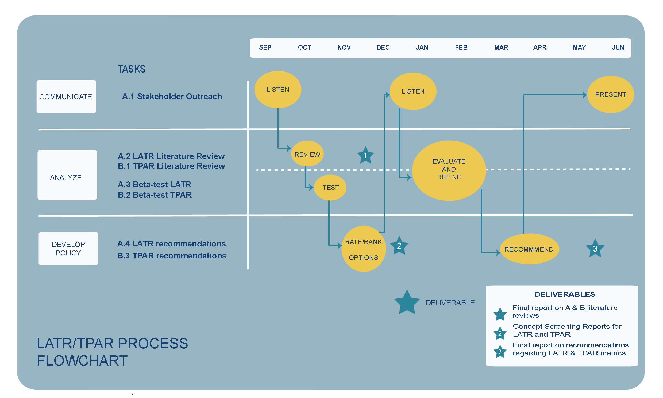
Project Flowchart

Slide 6
TISTWG Meetings
Proposed Schedule of topics
First Wednesday of each month
September 2014 – Introductions, purpose, schedule
October 2014 – Literature Review part 1, proposed screening processes
November 2014 – Literature Review part 2, screening/testing processes
December 2014 – Rate/rank screening options
January 2015 – Evaluation/refinement processes
February 2015 - Evaluation/refinement processes
March 2015 – Draft recommendations
April 2015 – Outreach/refinement
May 2015 – Final recommendations

Slide 7
Agency Perspectives
What does the Local Area Transportation Review process currently do well?
What are the principal limitations of the Local Area Transportation Review process?
How should those limitations be addressed?
What information (literature/testimonials, case studies, analyses) is needed to build support for such a change?

Slide 8
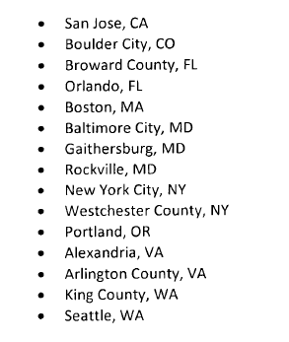
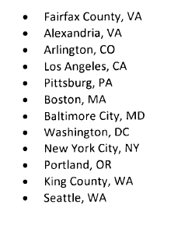
Lit Review
Two phases: LATR and TPAR, on similar schedules:
LATR TPAR
+3 others + 2 others

Slide 9
SB 743 Summary
Process:
State removing auto LOS as a required California Environmental Quality Act (CEQA) criteria
Locals still need to decide for selves
Proposed changes to State law, comment period through October
Technical:
OPR suggests VMT best replacement
Per unit
Significant impact if > regional average
Mitigation tools suggested, but silent on mitigation satisfaction
Do no harm?
Better than average?
Better than was?
Addressing safety

Slide 10
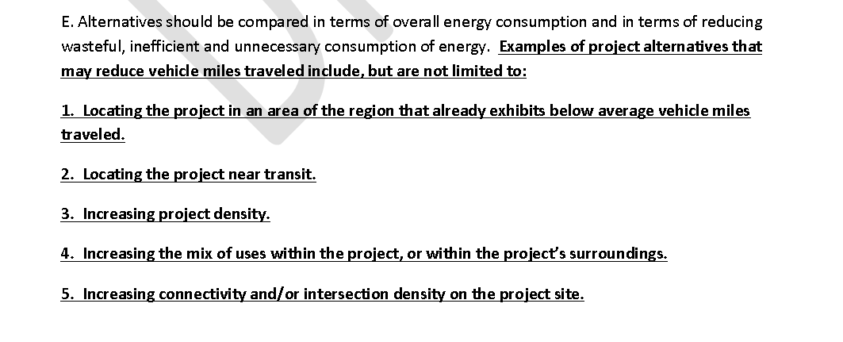
SB 743 Summary
OPR suggestions on minimizing VMT.

Slide 11
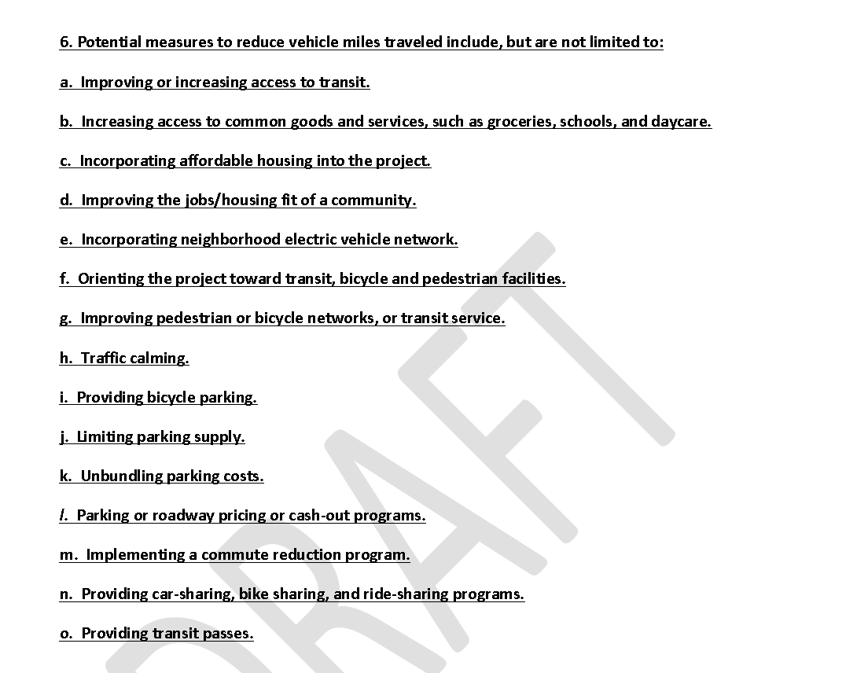
SB 743 Summary
OPR suggestions on mitigating VMT.

Slide 12
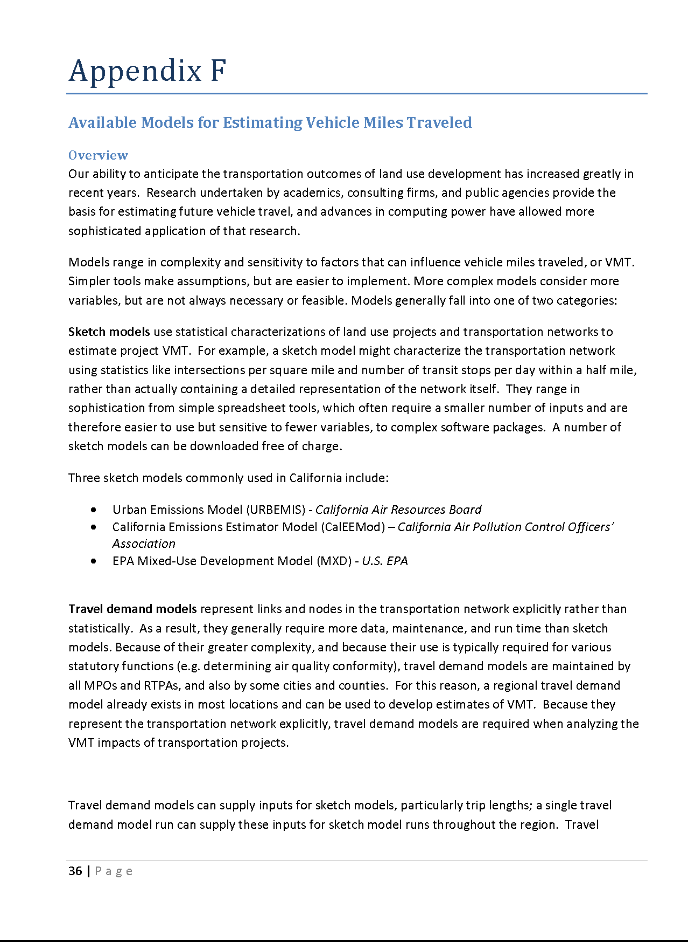
SB 743 Summary
Identified VMT Analysis Tools
VMT+
RapidFire
Transportation Emissions Guidebook and Calulator
Sketch7 VMT Spreadsheet Tool
COMMUTER
Envision Tomorrow
URBEMIS
CalEEMod
Smart Growth INDEX 2.0
Low-Carb Land
CommunityViz
TRIMMS
EMME
I-PLACE3S
STEAM
Urban Footprint
UrbanSim
EPA MXD tool
MXD+/Plan+/TDM+ Toolkit
CUTR_AVR
NEMS TSM
VMT Impact Tool

Slide 13
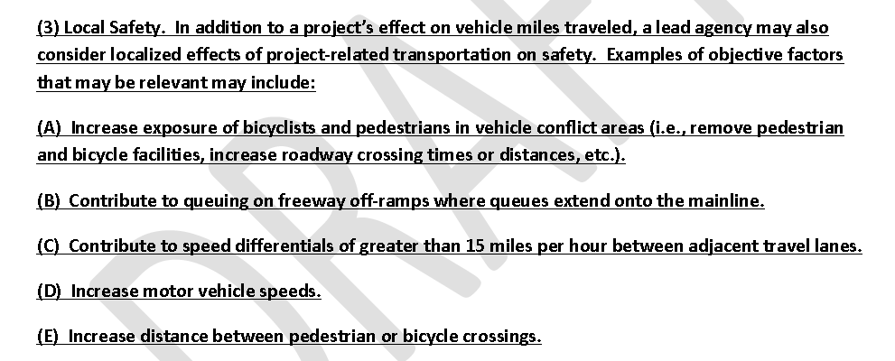
SB 743 Summary
SB 743 recommendations on safety suggest potential adverse impacts of project traffic on traveler safety.

Slide 14
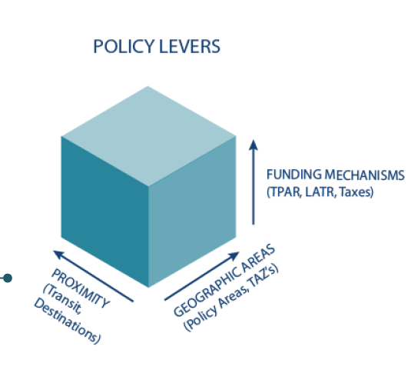
Potential LATR concepts
Starting point (entering literature review)
Pay-Go (San Francisco’s Auto Trips Generated)
Special Taxing District (White Flint)
Connectivity Index (Alachua County, FL)
LEED-ND
Multimodal Transportation District (Kissimmee, FL)
Multimodal LOS (various)
Operational network analysis in urban areas (Boston)

