Slide 1
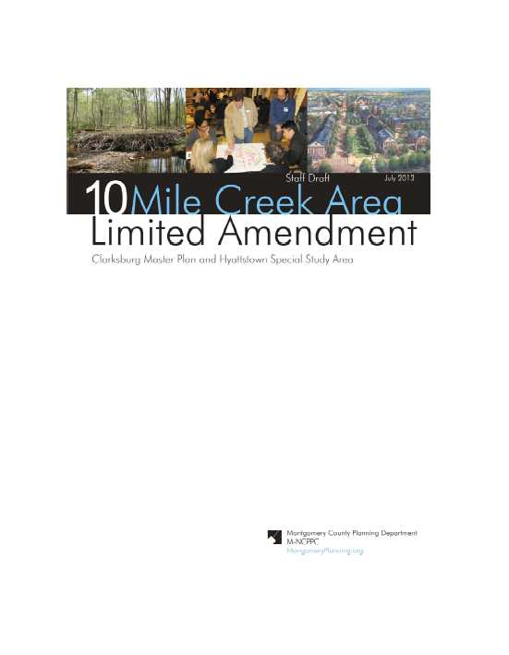
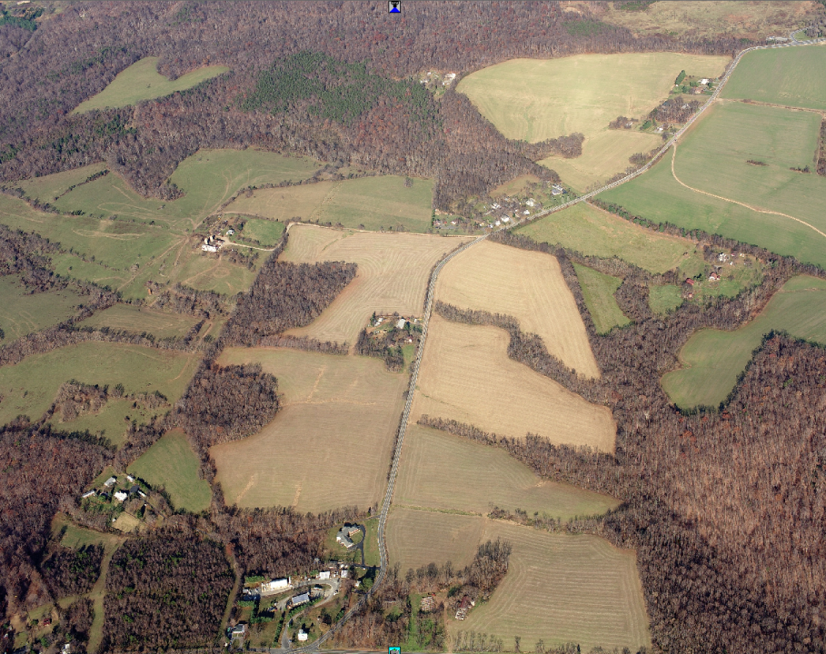
Clarksburg Limited Master Plan
Public Hearing Draft
Planning Board Worksession #1
September 26, 2013

Slide 2
Schedule
7/22- Planning Board Tour
7/22 Community Meeting to review Staff Draft Recommendations
7/25 – Planning Board review of Staff Draft Plan
9/10 – Public Hearing
9/26 – Planning Board Worksession #1
10/10 – Planning Board Worksession #2
10/24 Transmit Planning Board draft to County Executive and County Council
December –Council Public Hearing
December-February – County Council Worksessions, Council approval
February-April – Commission Adoption, Sectional Map amendment

Slide 3
Topics
What we believe
Overview of the key policy questions
Overview of the recommended land use/zoning concept
Consultant presentation
Potential changes to the Plan
Direction from the Board

Slide 4
Fundamental Question for Board
Based on the fact that Ten Mile Creek is as a very high quality reference stream in Montgomery County, and provided that staff sought guidance from multiple County, State and Federal agencies, including the EPA, is this a sensitive enough watershed to warrant protection through the application of impervious caps in conjunction with other measures, including ESD?

Slide 5
We Believe…..
A “planning level” analysis was the right approach to evaluate watershed-wide impacts and that the modeling methods are complete and the findings are sound;
Water quality, watershed ecology and stream biology all play important roles in determining watershed health;
Increased urbanization results in degrading all aspects of watershed health;
Environmental Site Design cannot by itself maintain watershed ecology or biology in sensitive, high quality streams;
Prudent planning dictates a combination of ESD and resource protection;
The Limited Amendment reflects prudent environmental, land use and zoning recommendations for this sensitive resource.

Slide 6
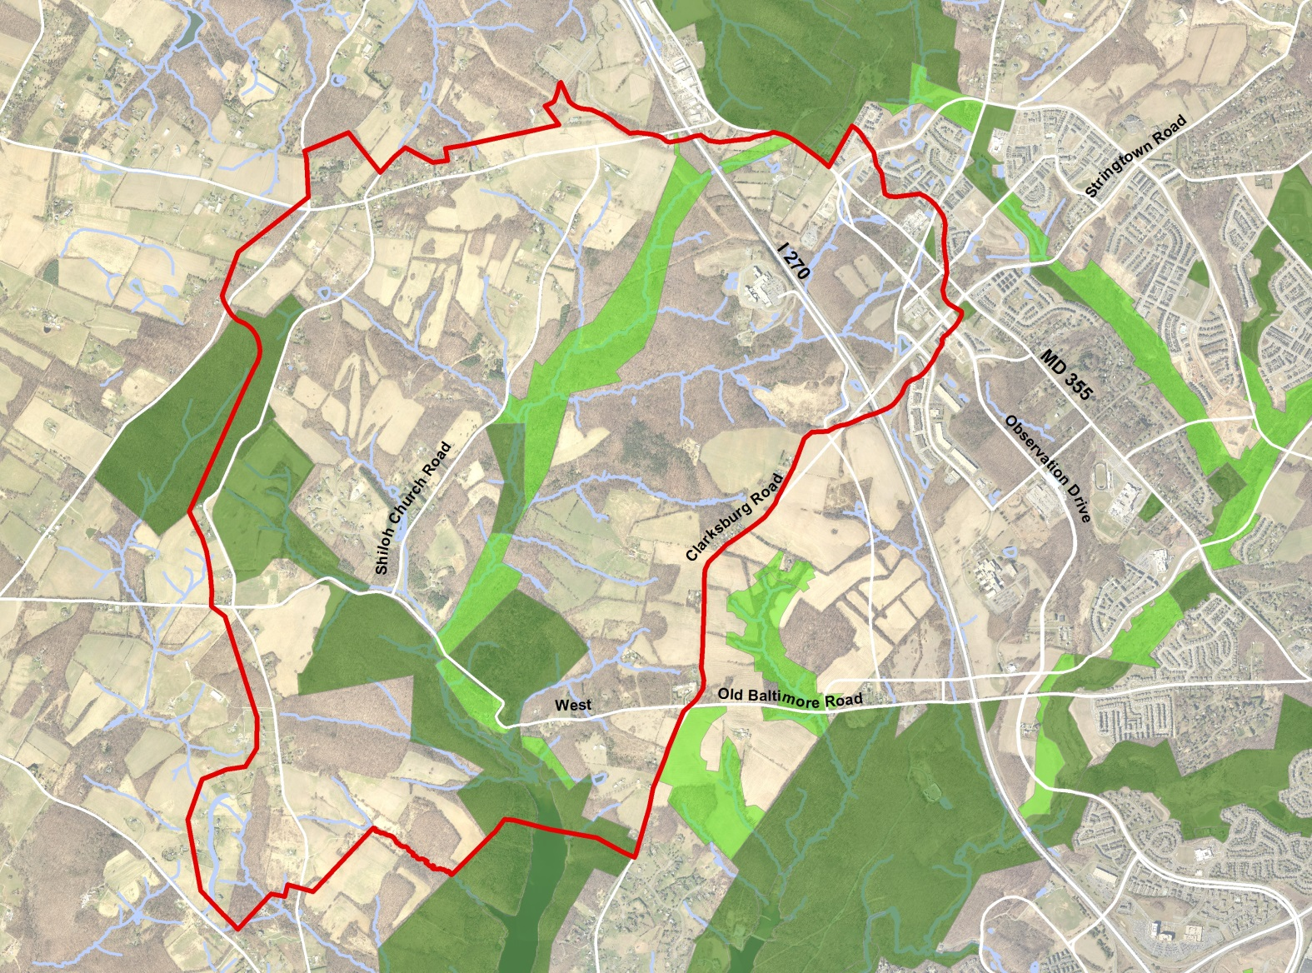
Orientation

Slide 7
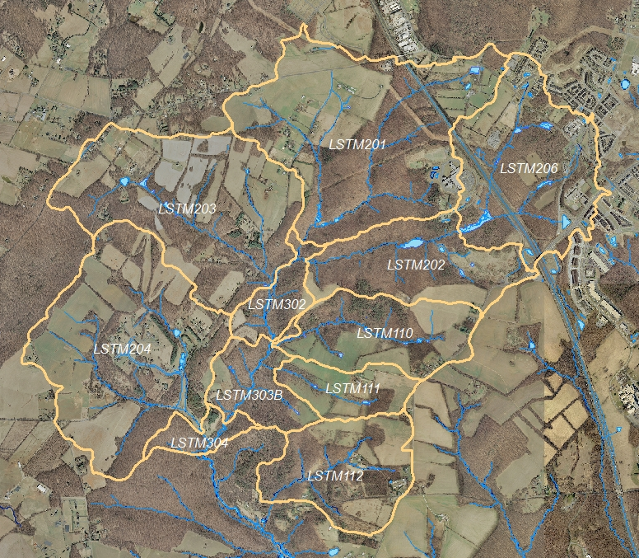
Sub Watersheds

Slide 8
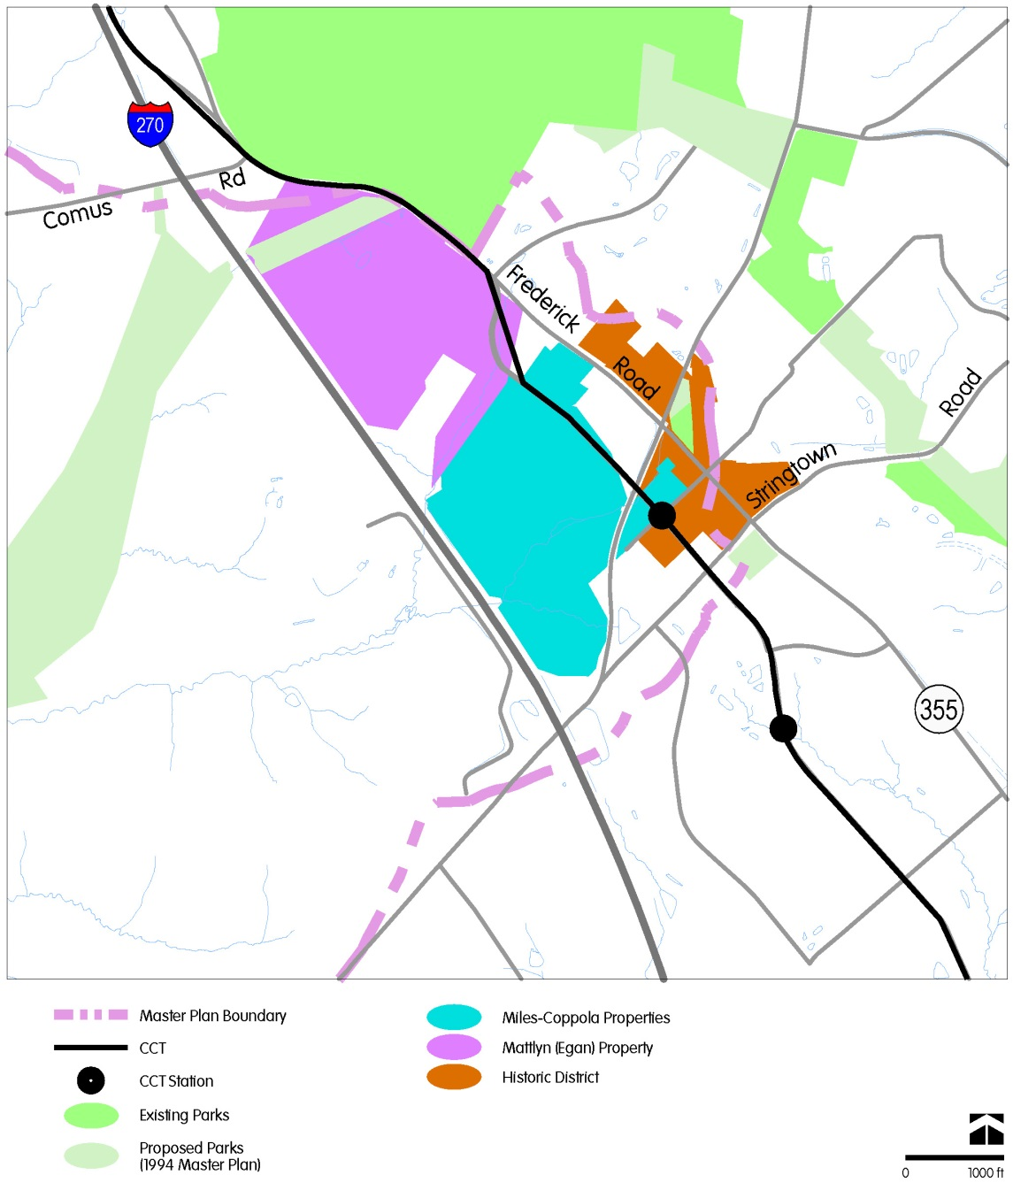
Property Locations

Slide 9
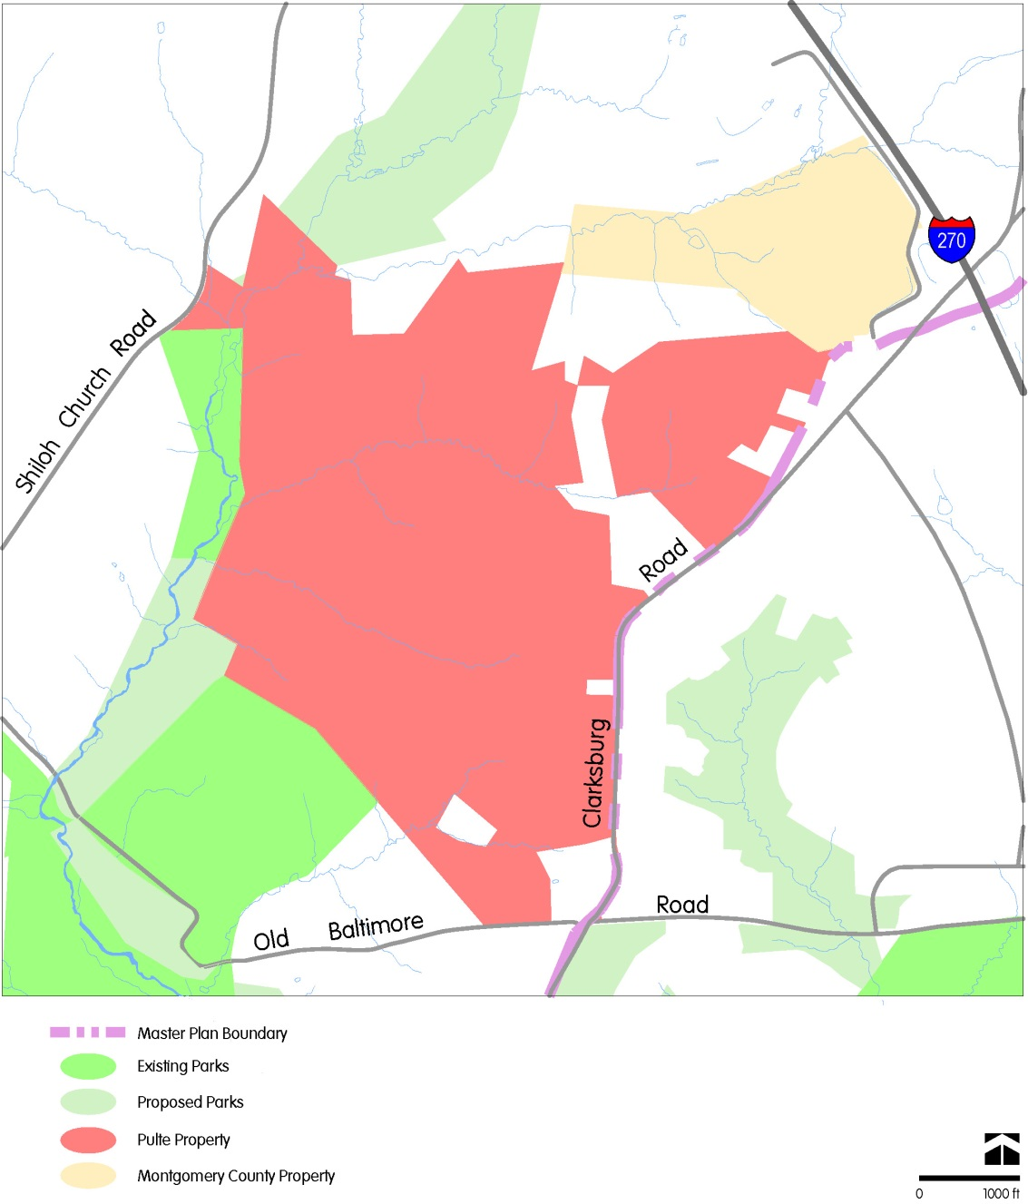
Property Locations

Slide 10
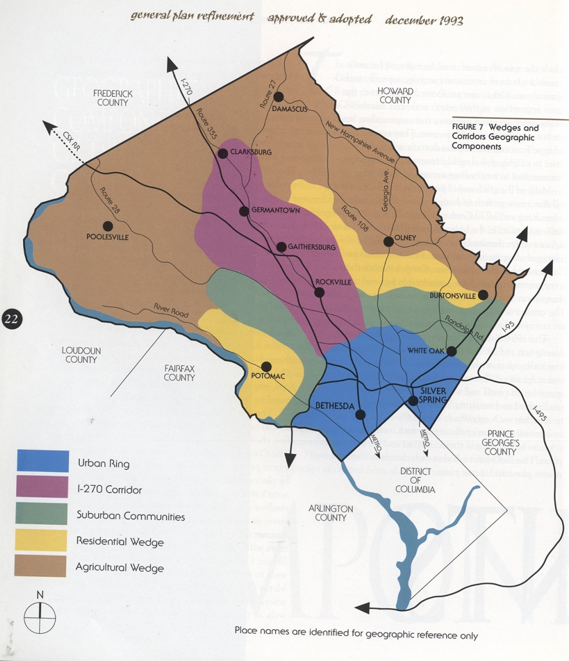
Amending the Plan
Clarksburg’s Evolution
General Plan
Becomes a fourth corridor city
1968 Clarksburg Plan
Scaled down to Corridor Town
1994 Clarksburg Plan
Reduces scale and balances environmental protection with transit supportable development
Town Center partly in Ten Mile Creek headwaters
Housing in Ten Mile Creek
Stages development

Slide 11
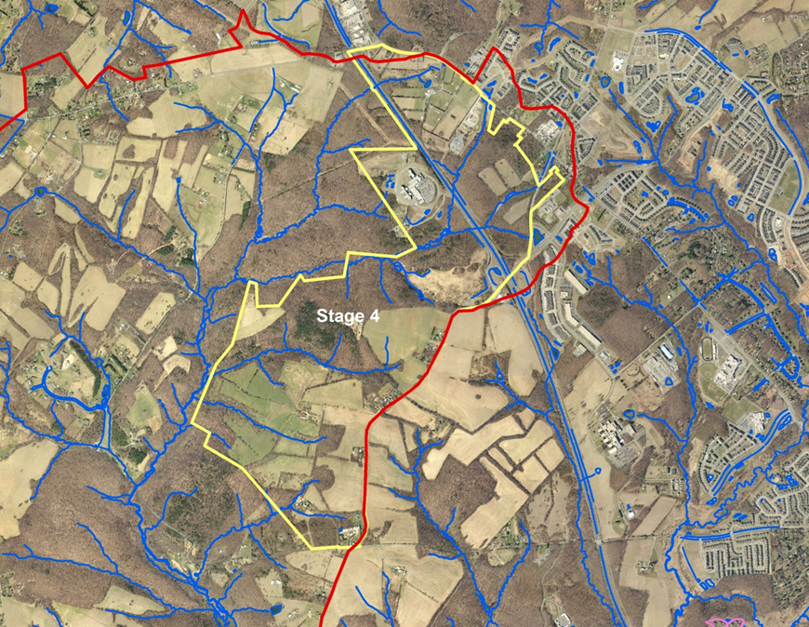
Amending the Plan
1994 Plan Staging
Stage 4 triggers have been met
Provided Council review at that time
Water quality evaluations complete, but inconclusive
Council has opted to prepare master plan amendment
May consider other land use actions

Slide 12
Amending the Plan
Policy Approach--refining earlier objectives
Geography sets the stage—Town Center on high ground, watersheds separated by roads along ridgelines, influencing land use goals and objectives
Acknowledges evolving environmental standards and lessons from other plans in sensitive Upper Paint Branch and Upper Rock Creek watersheds
Reflects consultants’ conclusions that innovative techniques and preservation of undeveloped open space should combine to maximize resource protection

Slide 13
Amending the Plan
Policy Approach--refining earlier objectives
East of I-270
recognizes balance struck in 94 Plan between Town Center and resource protection
imperviousness reduced while retaining mixed uses to reinforce the Town Center
West of I-270
continues housing uses and accommodate TDRs
recognizes that protecting sensitive resources requires reducing impacts on watershed’s highest quality tributaries
requires environmental site design and reduced imperviousness

Slide 14
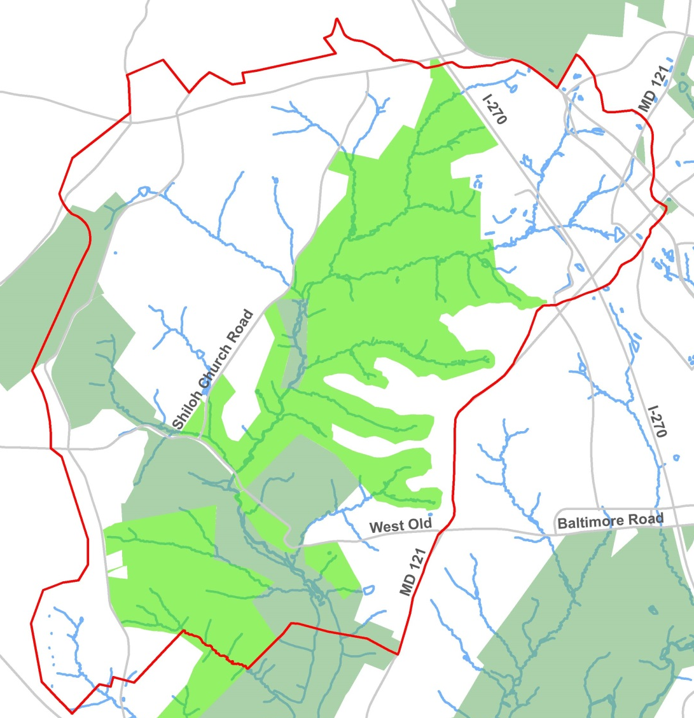
Public Hearing Draft Concept
Emphasize Environmental Protection
Preserve natural resources
Maximize undeveloped open space
Minimize imperviousness
Retain housing
  Emphasize Community Building
Complement Town Center
Strengthen Historic District
Balance Mixed Use
Improve Transportation

Slide 15
Protect Ten Mile Creek and Reservoir Above All
County Council indicated to consider all goals
Plan balances Ten Mile Creek protection with development in support of the 1994 Plan’s transit focus by concentrating growth in the Town Center District
1

Slide 16
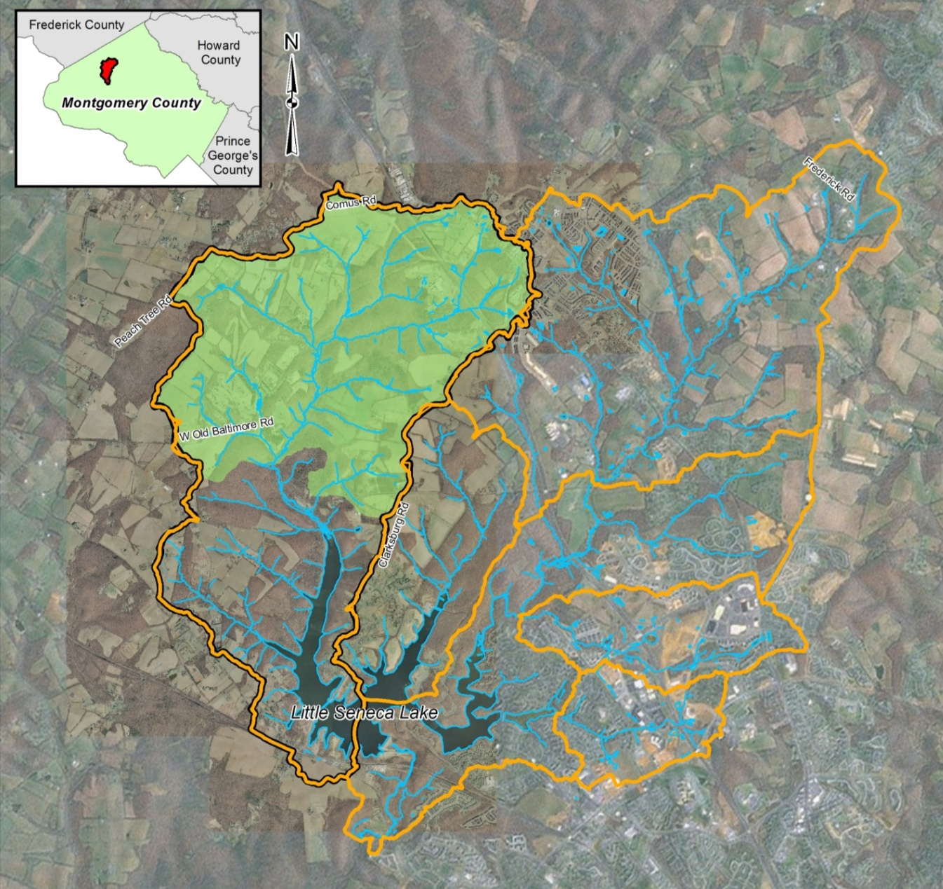
Little Seneca Lake Watershed

Slide 17
Little Seneca Reservoir
Part of a reservoir system that adds water to the Potomac during droughts – not a direct drinking source
Reservoir built with safeguards against sedimentation
Important to protect water quality, but protecting the Creek will protect the quality of the lake
Potential Impacts of Climate Change
  More extreme storms and droughts
  Impact on groundwater and total stream input to lake similar under different land use proposals
1

Slide 18
Status of Ten Mile Creek:
Status and Potential Risks
  One of the best quality streams in the County (Good to Excellent)
  One of three remaining principal reference streams in Western Montgomery County
    - The reference station is just downstream of LSTM 110 and 111, which are proposed in the 1994 Plan for significant amounts of development.
  An unusually sensitive watershed with thin rocky soils
  Has declined in biological health since 1995
  Small watershed changes can have significant biological effects in TMC
1

Slide 19
Confidence in Approach
Use a science-based approach
Vetting of approach
  Technical Overview
    EPA
    USGS
  Continuing Advice from:
    Maryland Department of the Environment
    Maryland Department of Natural Resources
    Montgomery County Department of Environmental Protection
    Montgomery County Department of Permitting Services
Best Data available at the watershed level

Slide 20
Guidance from the State of Maryland
Considered MDE, DNR, EPA and USGS Guidance on the Benefits and Limitations of ESD
Considered State Bay Critical Areas Protection Requirements
  combines limiting the footprint of development and impervious cover, with the use of ESD
  SWM and ESD BMPs are not granted credits towards the imperviousness limits

Slide 21
Biological Condition Gradient Results for TMC
Natural structural, functional, and taxonomic integrity is preserved
1
2
Minimal changes in structure and function
King Spring (invert)
Evident (e.g. measurable) changes in structure, minimal changes in function
3
Above Old Baltimore Rd (invert/fish)
Moderate changes in structure & evident changes in function
4
Biological
Condition
Below Old Baltimore Rd (invert/fish)
5
Major changes in structure & moderate changes in function
6
Severe changes in structure & function
Increasing Level of Stress

Slide 22
Science-Based Approach
No single model or tool can measure stream health or degradation
Combination of approaches used to formulate recommendations
  Documentation of existing watershed conditions
  Review of extensive biological monitoring data
  Field observations
  Scientific literature review
  Findings from nearby watersheds
  Hydrologic modeling
  Natural resources spatial analysis
  Pollutant load analysis
  Biological Condition Gradient Results for Ten Mile Creek
Planning level study
  Consistent level of detail and assumptions across the study area used to evaluate both existing conditions and different master planning scenarios
  All scenarios studied relative to existing conditions
1

Slide 23
Hydrologic Modeling Analysis
Many models available
Used XP-SWMM (originally developed by U.S. EPA)
Provides one tool to predict overall impacts of land use decisions
May be used to test a variety of land use alternatives
Relies on generalized stormwater management assumptions to represent range of site conditions and stormwater management effectiveness
Strength of the modeling approach is the emphasis on the predictive capability of comparable results under various development scenarios
Incorporates a level of conservatism to account for generalizations, variations and unknowns
1

Slide 24
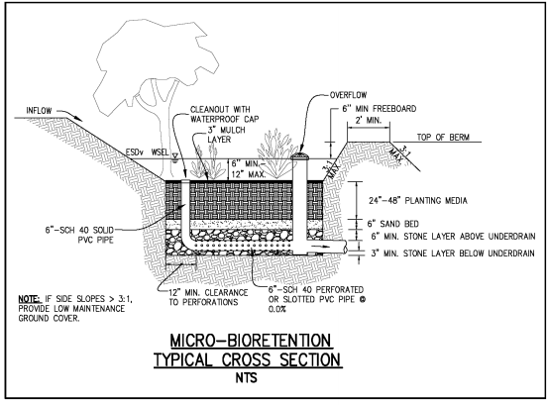
ESD – Environmental Site Design
Model represented standard microbioretention design
ESD model parameters developed in consultation with Planning, DEP and DPS
Clarification to H&H report on how ESD modeled
Montgomery County’s Micro-Bioretention Design Standard
    Ponding above media - 9”
    Infiltration to planting media
    Overflow to outlet
    Underdrains with overflow to surface waters
1

Slide 25
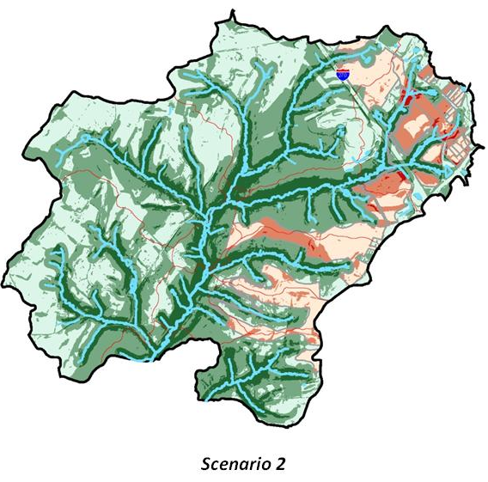
Analysis Considered Many Important Factors
ESD practice limits
Increased annual runoff volume
Construction phase impacts
Collective modifications to vegetation, soils & hydrology
Changes in infiltration & evapotranspiration
1994 Master Plan Scenario
Forest Interior NOT Included
1

Slide 26
Environmental Analysis Conclusions
East of I270 - highest levels of existing impervious cover and fair stream conditions
West of I270 - dominated by small, high quality tributaries, forest cover and rural land uses
Increases in stormwater runoff expected despite application of ESD practices
ESD does represent the state of the practice for site and subdivision development
Rigorous and comprehensive implementation across or within watersheds has not occurred nor been monitored

Slide 27
Rationale for Resource Protection and Community-Building Recommendations
In sensitive watersheds, Council has taken this same approach:
  Concentrate growth where necessary in a part of the watershed that is consistent with community-building goals
    Upper Rock Creek
    Burtonsville
    Damascus
    Olney
  The 8% cap is considered a standard for protection - allows some buffer for increasing imperviousness over time and the degradation of stormwater BMP’s
  All properties are being cut back proportionately from expected imperviousness levels
1

Slide 28
Options
  No Build 4% imperviousness
    Ag Reserve on West Side including County property
    Parkland on East side
    No Bypass
    Keep Fire Station and Historic District development
    Retrofit existing untreated areas at public cost
    Requires public extension of sewer to HD

Slide 29
Options
  Low Build 6% imperviousness
    All developable properties = RC
    No Bypass
    Keep Fire Station and Historic District development
    Requires public extension of sewer to HD

Slide 30
Options
  Low Build with Focus on Community Building 6% imperviousness
    Egan = RC
    Miles/Coppola = CR
    Keep Fire Station and Historic District development
    Pulte = RDT
    County property = parkland

Slide 31
Options
  Public Hearing Draft
    Egan = R200
    Miles/Coppola = CR
    Build Bypass
    Keep Fire Station and Historic District development
    Developer provides sewer to Historic District
    Pulte = RNC 8% cap
    County property = 8% cap

Slide 32
Options
  Property Owner requests
    Egan = R200
    Miles/Coppola = CR 35% cap
    Build Bypass
    Keep Fire Station and Historic District development
    Developer provides sewer to Historic District
    Pulte = RE-1/TDR 15% cap
    County property = 15% cap

Slide 33
Options Summary
 | No Build | 6% Spread | 6% Concentrated | PH Draft | Developers
Egan | Park | RC | RC | R200 | R200
Miles/Coppola | Park | RC | CR | CR | CR
Fire Station | Build | Build | Build | Build | Build
Historic Dist. | Build | Build | Build | Build | Build
Bypass | No | No | Build | Build | Build
Public Sewer | County | County | Developer | Developer | Developer
County | RDT | RC | RC | RNC | RNC
Pulte | RDT | RC | RDT | RNC | RE1/TDR
Impervious in LSTM110 | 1.6% | 6.4% | 5% | 8% | 17%
Overal Imp. | 4+% | 6+% | 6+% | +/-8% | 10%
LOWER RISK
HIGHER RISK

Slide 34
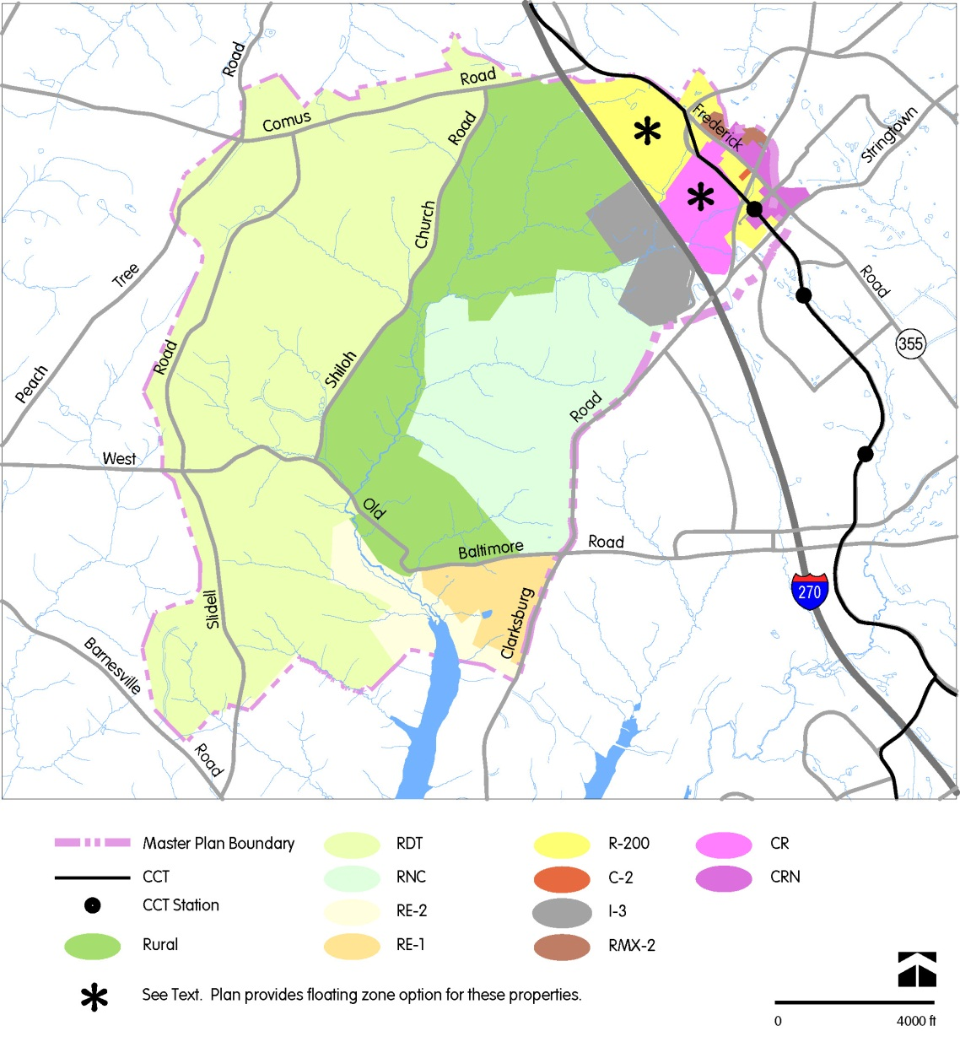
Staff Draft Master Plan
Recommendations
Land Use and Zoning
Zoning recommendations respect 94 Plan density transition from Town Center to Ag Reserve
CR zones allow market conditions to help guide development decisions
Floating zone options allow focus on residential uses while retaining some commercial potential

