Slide 1
GSSC Implementation Advisory Committee Presentation
February 11, 2014
1

Slide 2
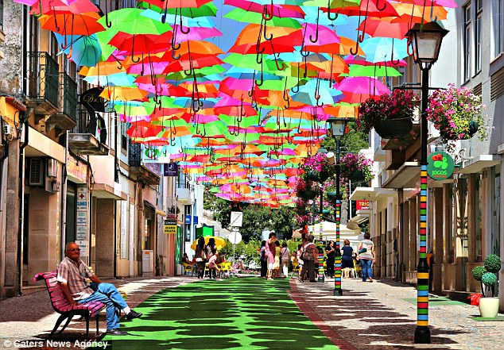
What Makes a Good Place?

Slide 3
What Makes a Good Place?
Accessibility
Well connected mobility and open space networks
Legibility
Well designed buildings and landmarks to define the public realm
Mixed uses
Combination of uses and activities to encourage pedestrians and visitors
Sociability
Public domain activation that invites and sustains social interaction

Slide 4
What Makes a Good Place?
Accessibility
Well connected mobility and open space networks
Choice of routes
Short blocks
Shared facilities for multiple travel modes
Wide sidewalks and safe intersections
Variety of flexible open spaces to accommodate various types of community functions and activities

Slide 5
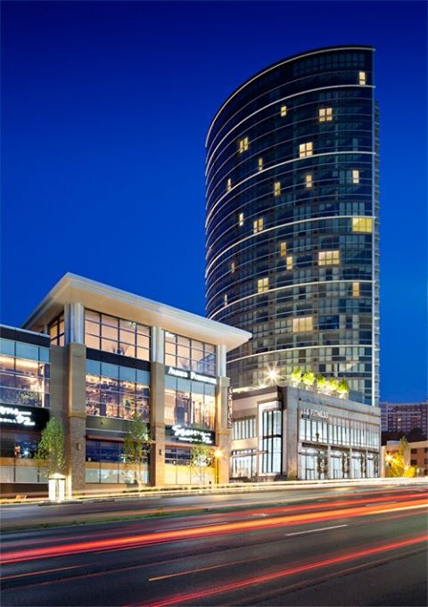
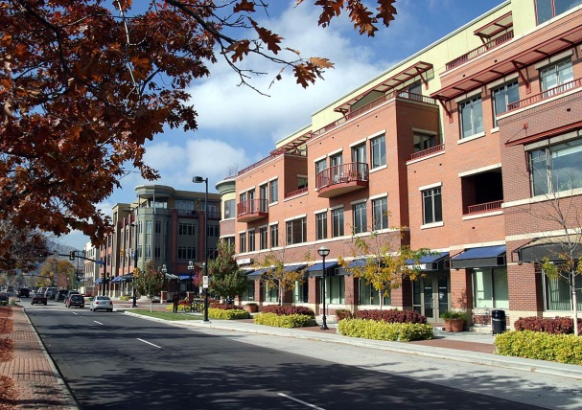
What Makes a Good Place?
Legibility
Well designed buildings and landmarks to define the public realm
Mix of building types
Urban scale
Street-defining buildings with ground floor active uses
Landmark structures to visually organize development
Open spaces that are clearly contained by well-designed development

Slide 6
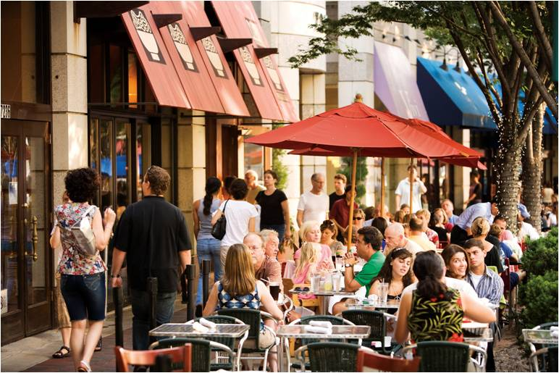
What Makes a Good Place?
Mixed uses
Combination of uses and activities to encourage pedestrians and visitors
Clustered activities
Integrated development
Mutually supportive use mix
Create centrally located community serving centers

Slide 7
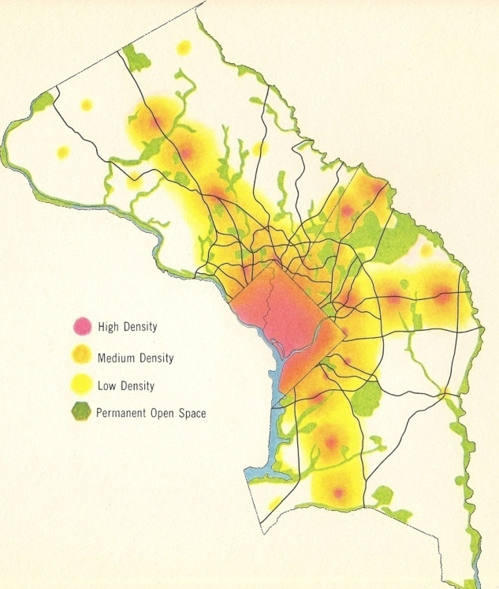
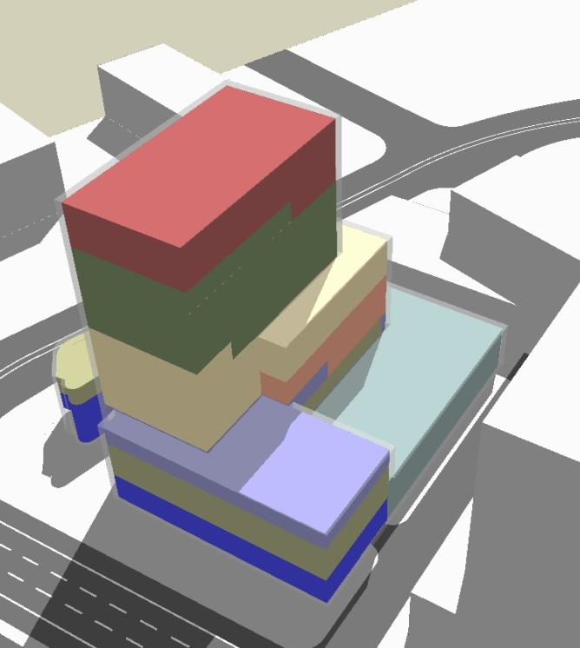
Regulatory Framework
General Plan
Master Plans
Design Guidelines
Policy Framework
Land Use
Growth Management
Resource Management
Mobility
Land Use and Zoning
Urban Form and Public Space
Sustainability
Streets
Public Use Space
Buildings
Sustainability
1

Slide 8
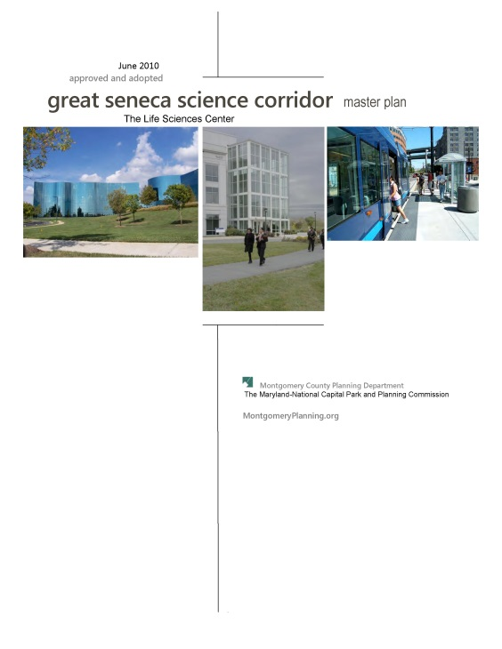
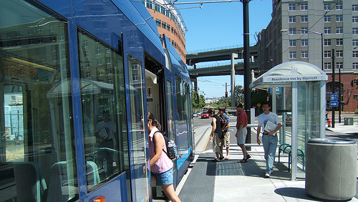
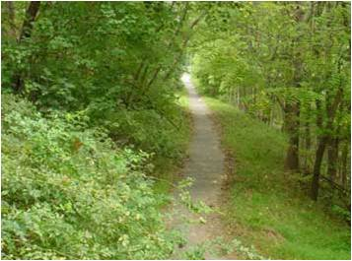
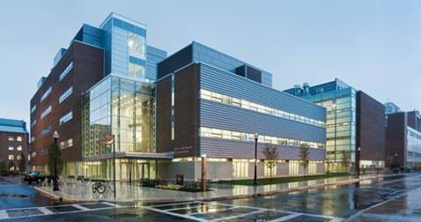
Great Seneca Science Corridor
Promote integration of new technologies into building design and community planning.
1

Slide 9
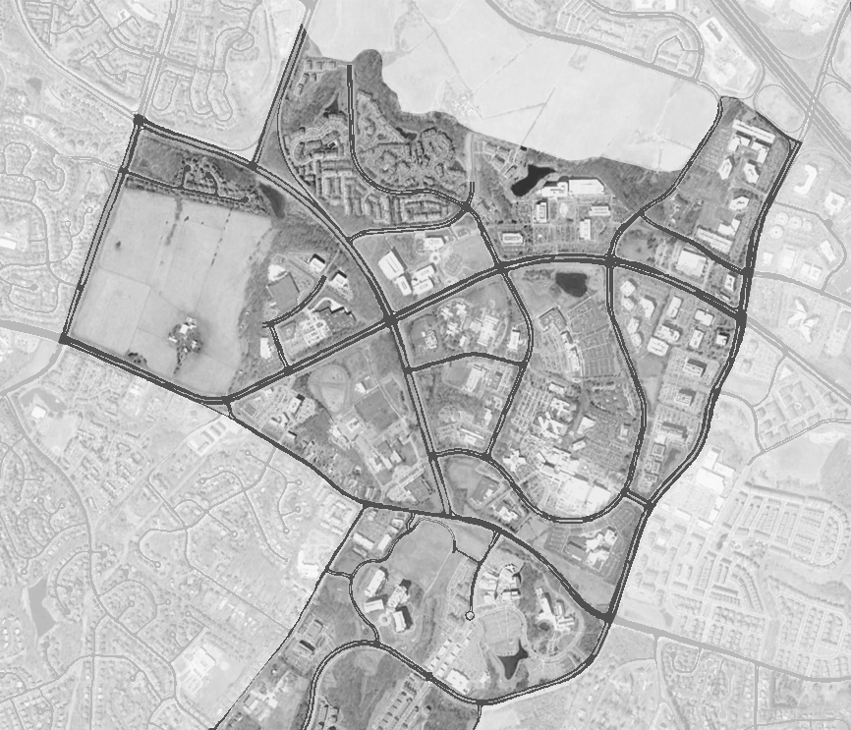
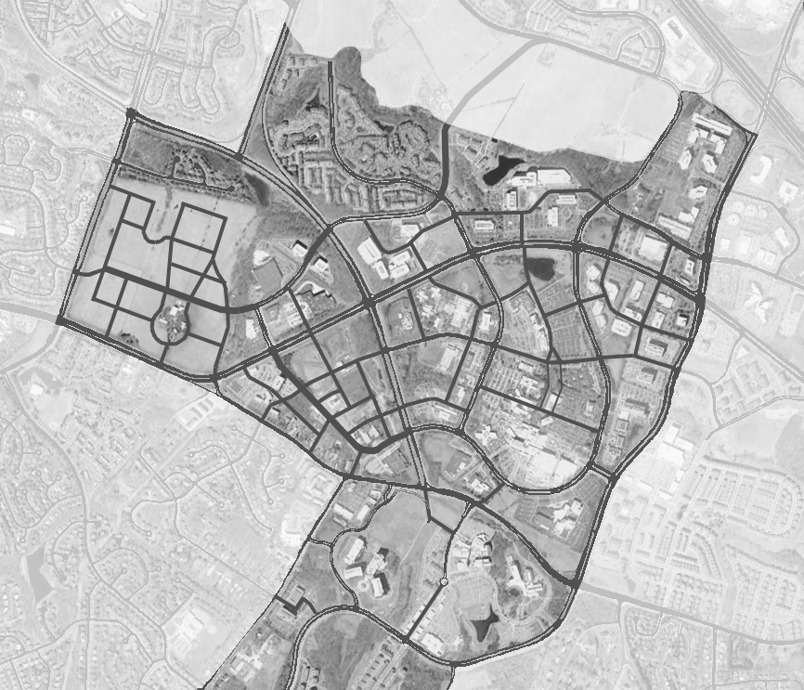
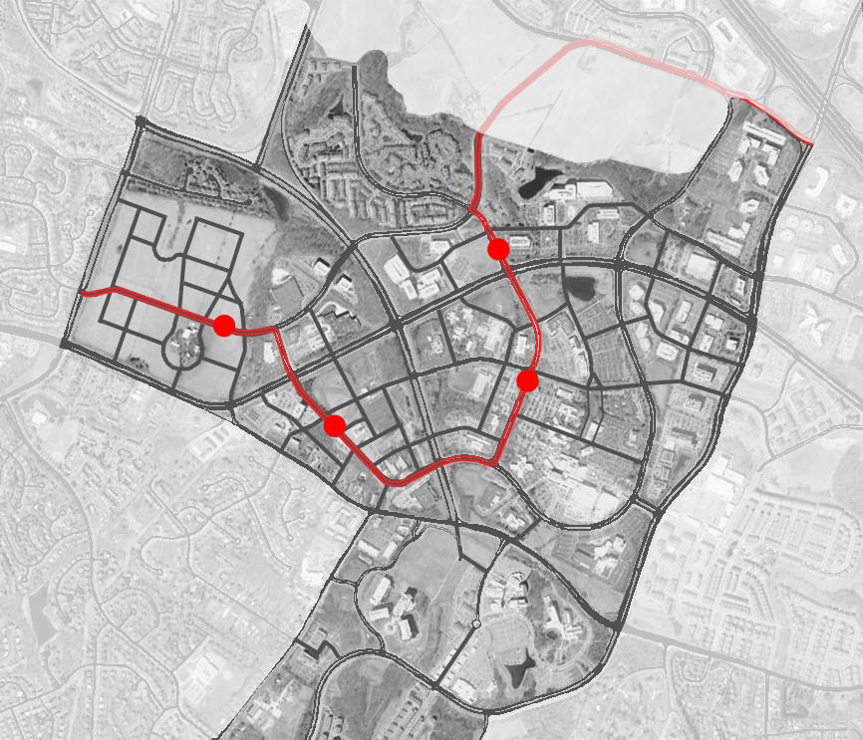
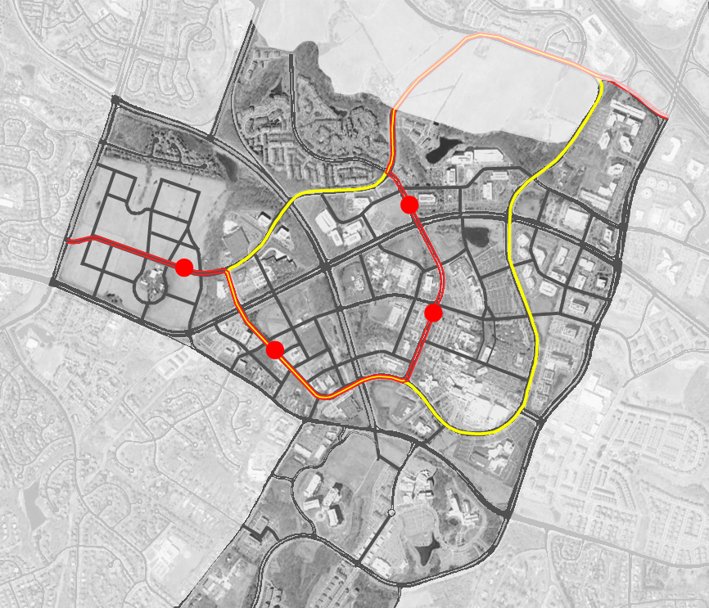
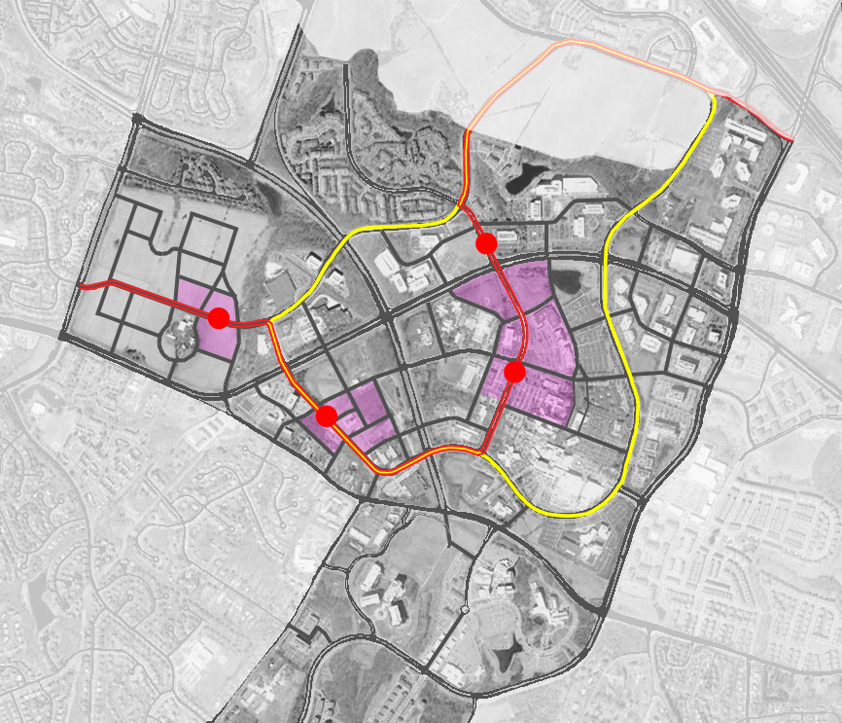
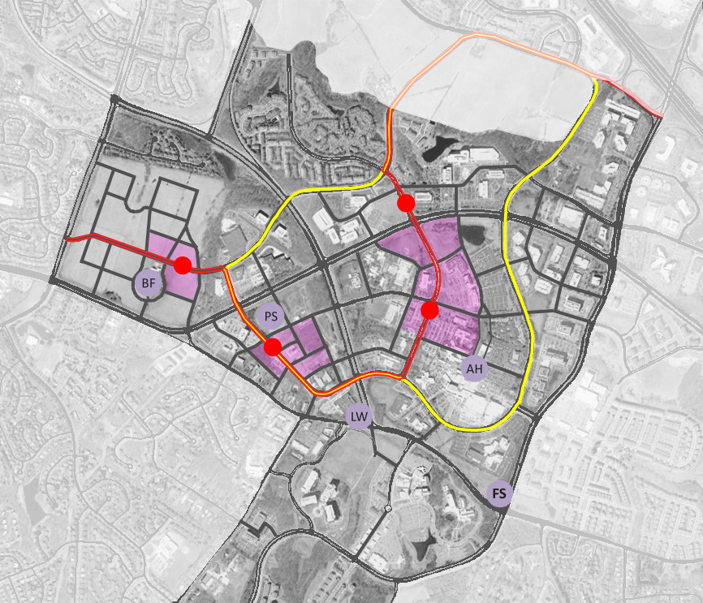
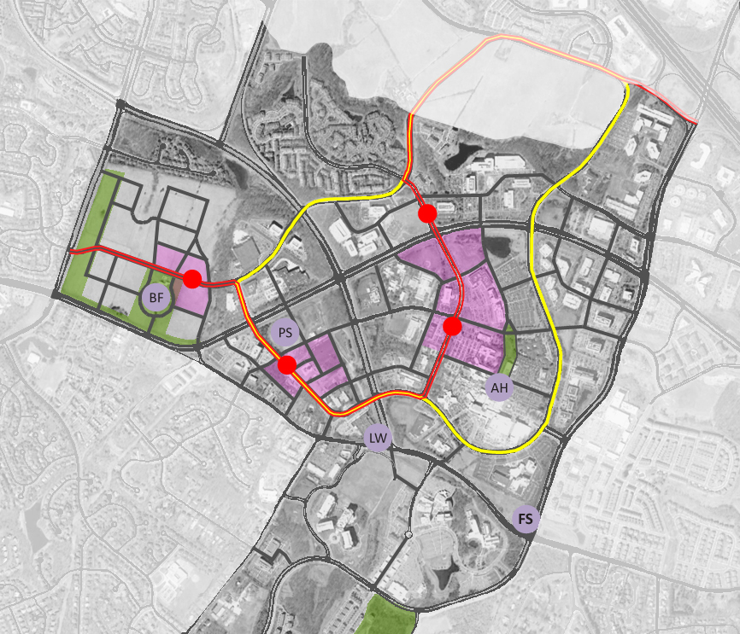
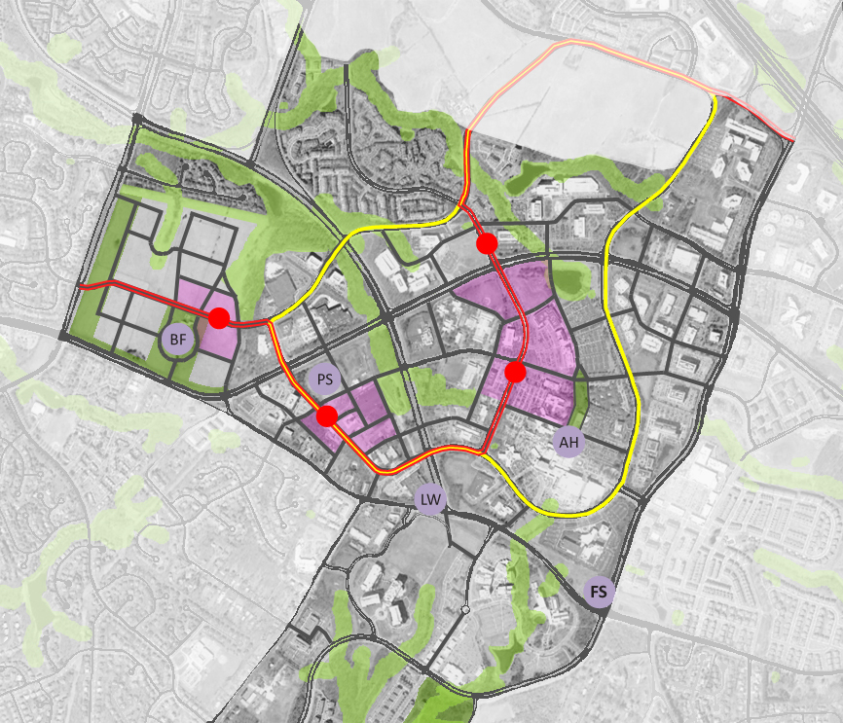
Plan Vision
Establish a street network
Extend CCT
Create LSC Loop
Cluster taller buildings
Identify local landmarks
Create new open spaces
Link with stream network

Slide 10
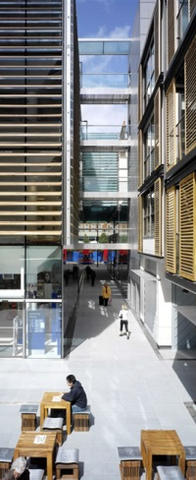
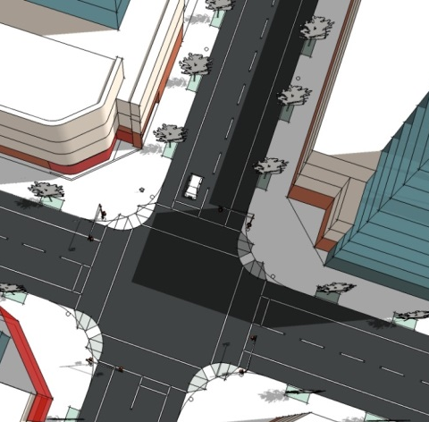
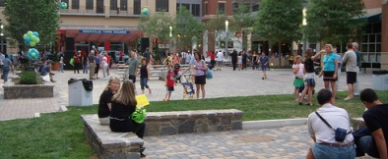
Design Guidelines
Buildings and Landmark Structures
Streets
Open Space
1

Slide 11
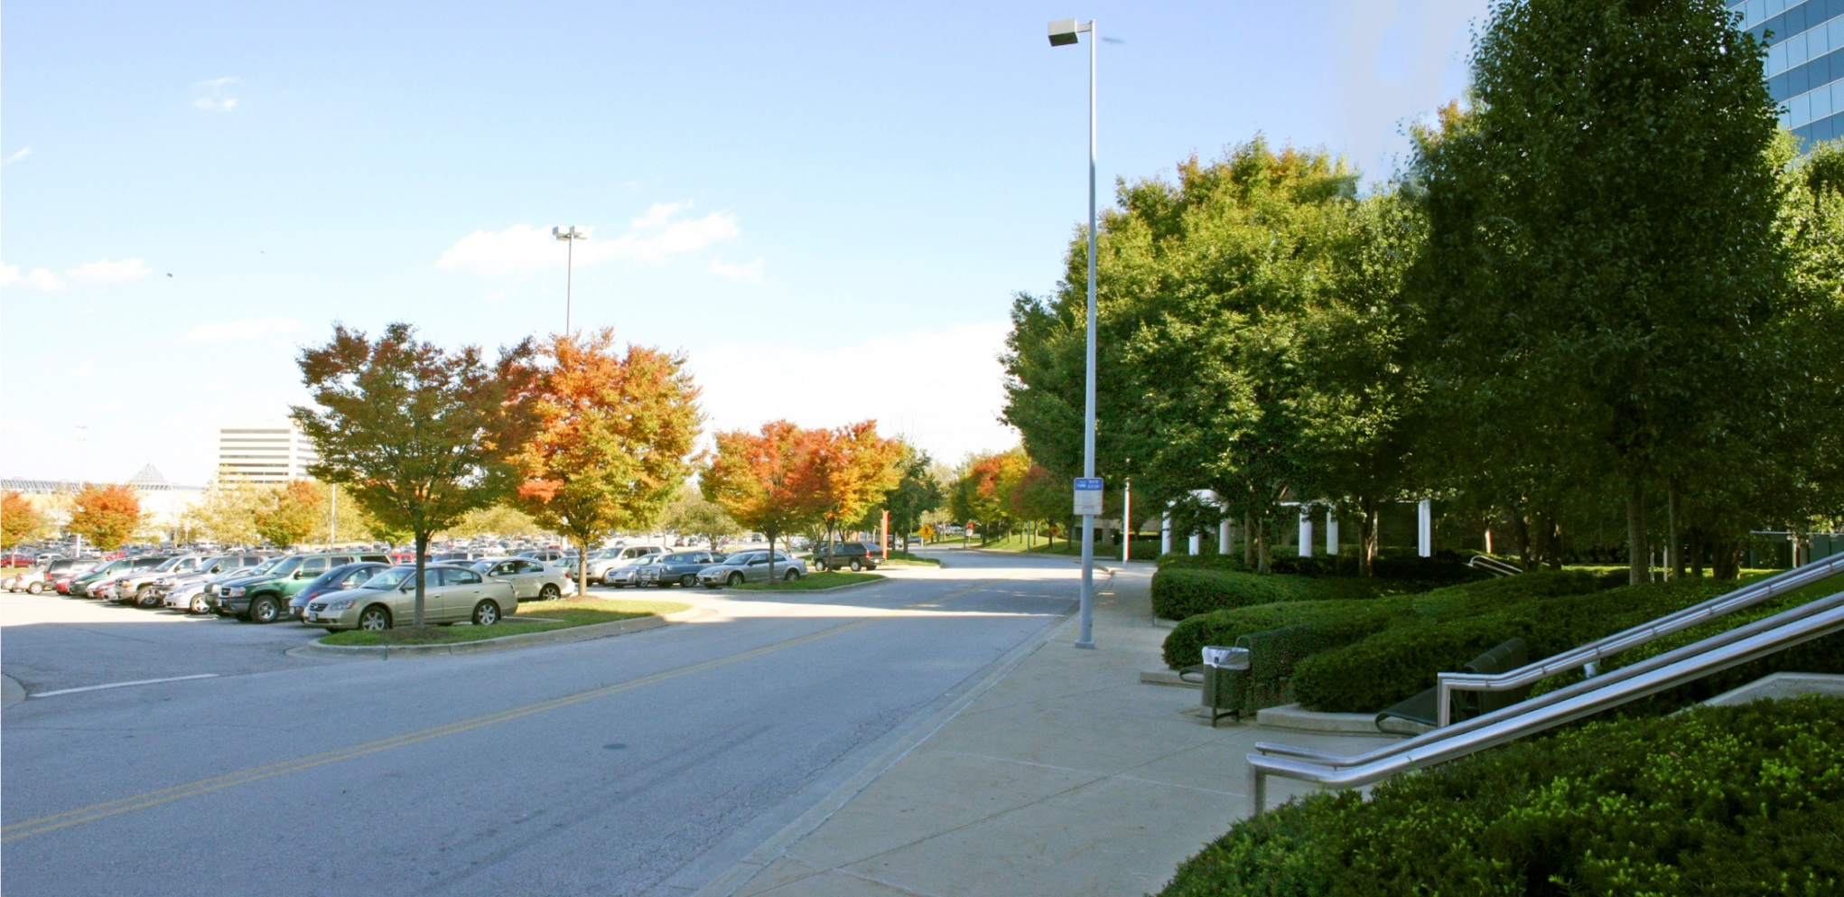
Incremental Transformation
Image: Design Collective Inc., Architects

Slide 12
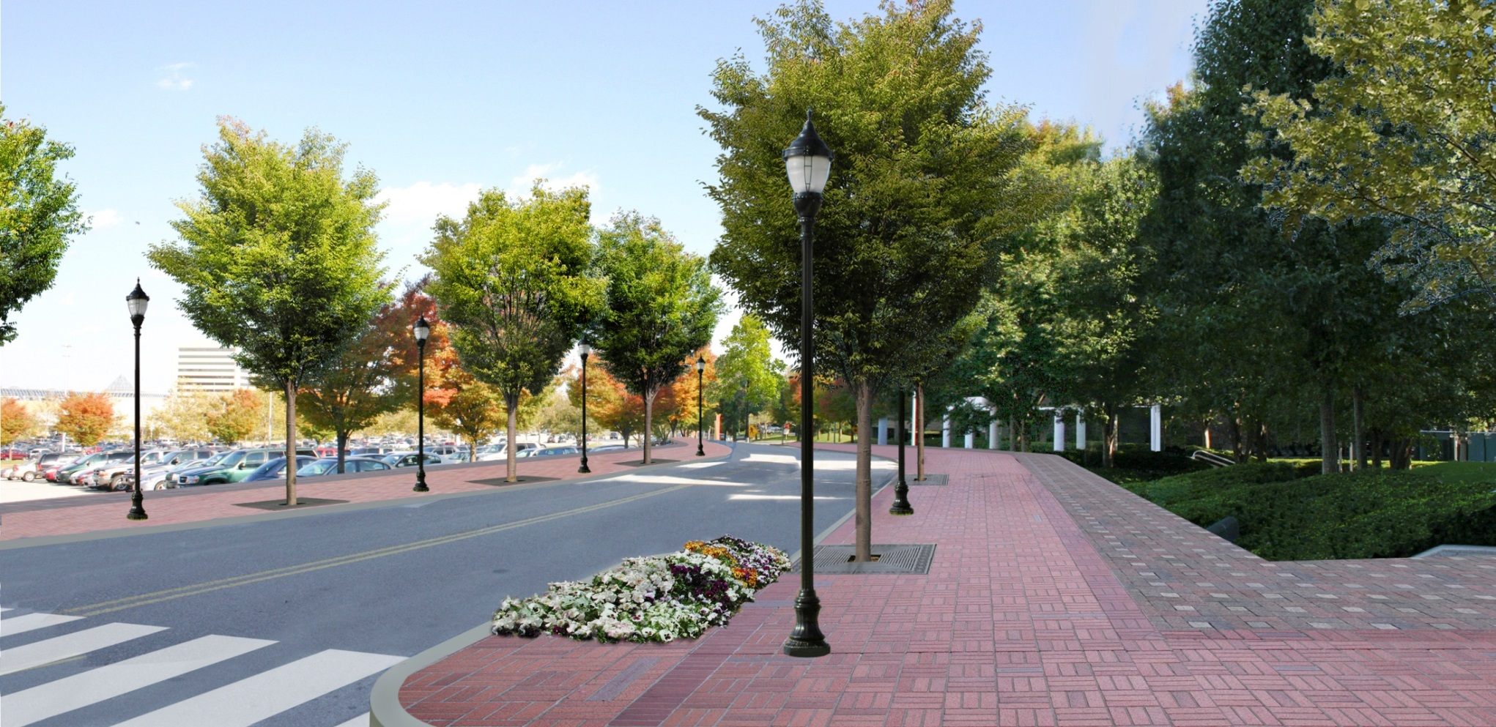
Image: Design Collective Inc., Architects

Slide 13
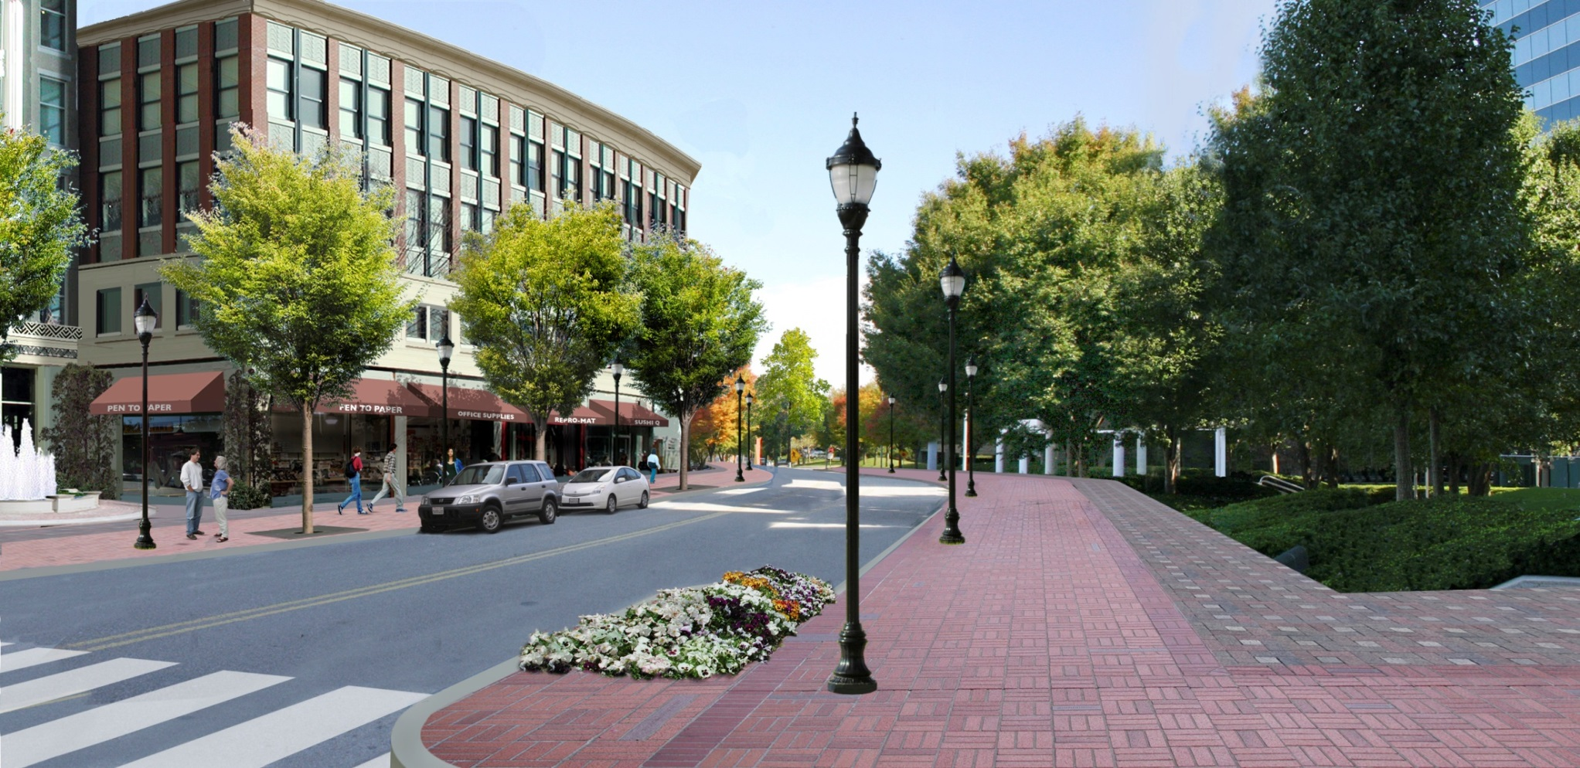
Image: Design Collective Inc., Architects

Slide 14
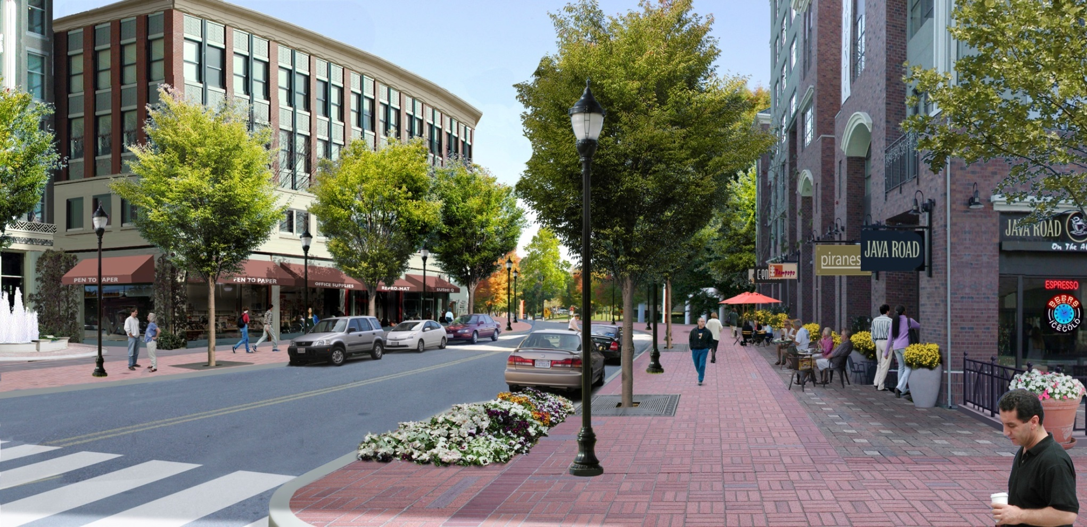
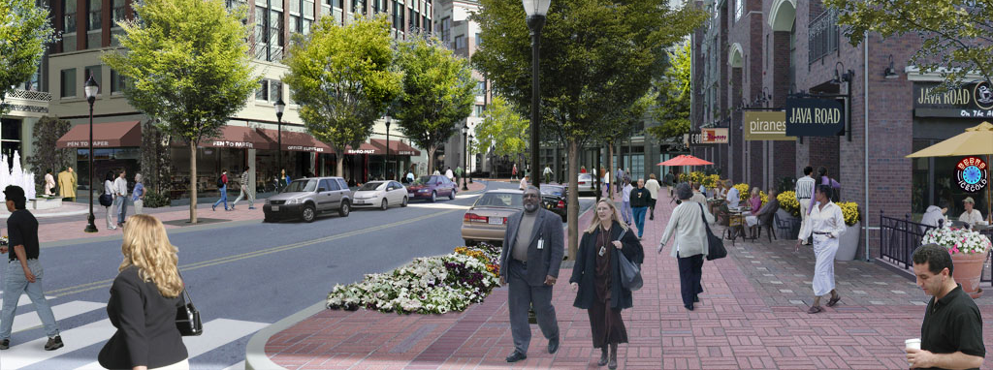
Image: Design Collective Inc., Architects

Slide 15
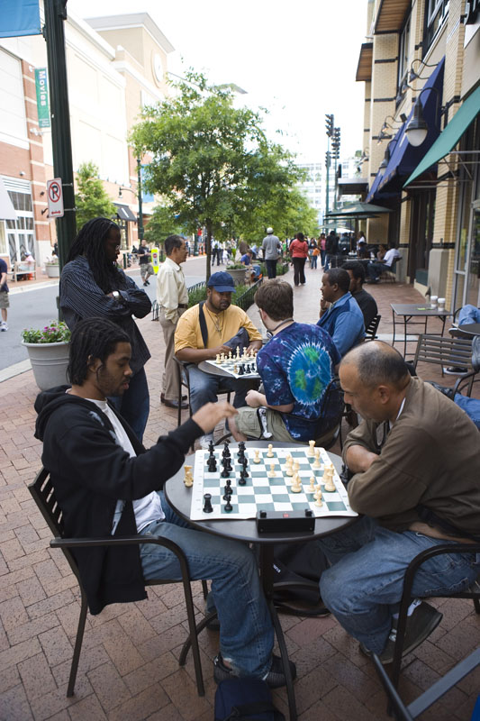
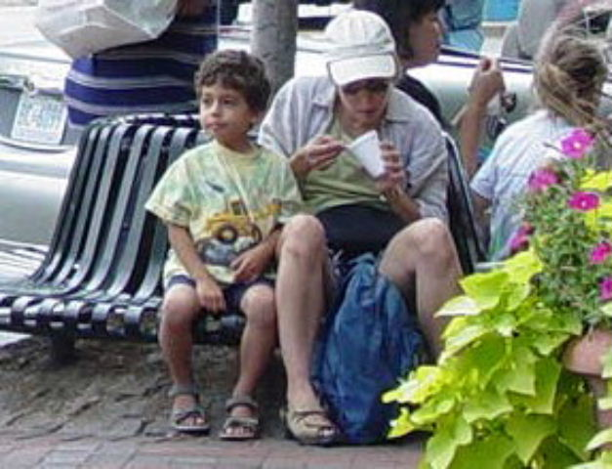
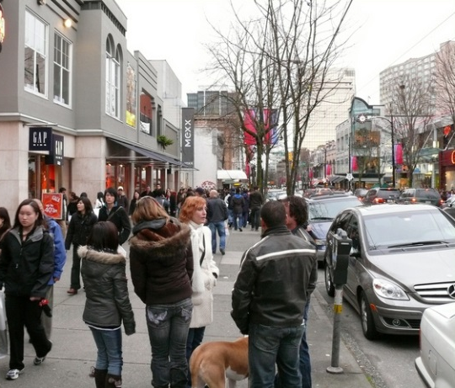
What Makes a Good Place?
Sociability
Public domain activation that invites and sustains social interaction
Multiple activities and destinations
Public Art
Showcase local assets
Promote authenticity
Develop innovative space management strategies
ADAPTABLE SPACES

Slide 16
Questions?

